Slide 1
BAAR Phase 1 Overview
BAAR Collections Training
BAAR Phase 3 Training

Slide 2
Table of Contents
Segment 1: Collections Overview
Segment 2: Cash Receipt Documents
Segment 3: Collections Query
Segment 4: Collections Processing
Segment 5: Collection Discrepancies
Segment 6: CIR Reconciliation
Segment 7: Collections Reports
Segment 8: Mass Import

Slide 3
Segment 1:
Collections Overview

Slide 4
Table of Contents
Segment 1: Collections Overview
Collections Lifecycle
Collection Methods
Cash Receipt Introduction
Segment 2: Cash Receipt Documents
Segment 3: Collections Query
Segment 4: Collections Processing
Segment 5: Collection Discrepancies
Segment 6: CIR Reconciliation
Segment 7: Collections Reports
Segment 8: Mass Import

Slide 5
Dunning
Collections Lifecycle

Slide 6
Collections Lifecycle Overview
Collections Lifecycle Overview:
GSA collection processes fall into one of four receivable lifecycles:
Detail Billing Record (DBR) Receivables
Project Cost Accounting (PCAS) Receivables
PCAS/DBR Hybrid Receivables
Non-PCAS/Non-DBR Receivables
Collections are received in Pegasys to:
Record cash
Liquidate outstanding receivables
Collections are received through a variety of Collection Methods (see diagram on next slides)
Notes:
Note: Not all steps will apply to every Receivable. These are potential events in the Accounts Receivable (AR) Life Cycle.
The DBR Receivables Lifecycle includes:
Initiating Billing Records in Feeder System
Establishing DBR Records in Pegasys
Generating Receivable and Advanced Offset
Sending Bill to Customer/Sending Billing Data to Treasury
Recording Accruals (when applicable)
Tracking Receivable and Recording Overdue Charges
Recording Collection
Tracking and Managing Disputes/Chargebacks
Processing Write-offs and Adjustments

Slide 7
DBR Receivables Lifecycle – Collections
Initiate Billing Records at Feeder System
Record Collection
Disputes/
Chargeback
Process Write off/ Adjustment/ Treasury Referral
Establish Detail Billing Records in Pegasys
Generate Receivable and Earned Revenue
Send Bill to Customer
Track Receivable & Record Overdue Charges
Pegasys Connect
FMESB
DBR Import
DBR Crosswalk
DBR Summarization
Automated Credit Application
IPACOUT
ARBILLGEN
ARREFERSEL
ARTREOEX
AREOCOLL
IPACIN
IPACIN
IPACIN
LOCKBOX
Pay.Gov via CIR
Manual
AROVERDUE
ARDUNNING
Not all steps will apply to every Receivable. These are potential events in the Accounts Receivable (AR) Life Cycle.
Notes:
Note: Not all steps will apply to every Receivable. These are potential events in the Accounts Receivable (AR) Life Cycle.
The DBR Receivables Lifecycle includes:
Initiating Billing Records in Feeder System
Establishing DBR Records in Pegasys
Generating Receivable and Advanced Offset
Sending Bill to Customer/Sending Billing Data to Treasury
Recording Accruals (when applicable)
Tracking Receivable and Recording Overdue Charges
Recording Collection
Tracking and Managing Disputes/Chargebacks
Processing Write-offs and Adjustments

Slide 8
PCAS Receivables Lifecycle – Collections
Agreement
Record Pre-Billing Transactions
Receivable - Advance Offset
Agreement Interface
Advances
Spending
Surcharges
PCPROJBILL
Bill Customer
Accruals
Track Receivable & Record Overdue Charges
AROVERDUE
ARDUNNING
Credit Application
IPACOUT
ARBILLGEN
Write off/ Adjustment/ Treasury Referral
Disputes -
Chargebacks
Record Collection
IPACIN
LOCKBOX
Pay.Gov via CIR
Manual
IPACIN
ARREFERSEL
ARTREOEX
AREOCOLL
IPACIN
Not all steps will apply to every Receivable. These are potential events in the Accounts Receivable Life Cycle.
Notes:
The PCAS Lifecycle includes:
Establishing Agreements in Pegasys
Record Pre-Billing Transactions
Collecting Advances and Security Deposits Received (when applicable)
Spending against Agreement (when applicable)
Assessing Surcharges as appropriate against Agreement
Generating Receivable and/or Advance Offset
Sending Bill to Customer/Sending Billing Data to Treasury
Recording Accruals (when applicable)
Tracking Receivable and Recording Overdue Charges
Recording Collections
Tracking and Managing Disputes and Chargebacks
Processing Write-offs and Adjustments
Spending against Agreement (when applicable)
NOTE: No Spending for Region 7
Sending Bill to Customer/Sending Billing Data to Treasury
NOTE: No PCAS billing will be sent to Treasury. Phase 3 are all nonfederal customers for Region 7
Recording Accruals (when applicable)
NOTE: No accruals through PCAS for R7
Tracking and Managing Disputes and Chargebacks
NOTE: No Chargebacks for R7

Slide 9
DBR/PCAS Hybrid Lifecycle
Establish Agreement
Initiate Billing Records at Feeder System
Establish Detail Billing Records in Pegasys
Generate Receivable and /or Advance Offset
Record Accrual
Record Collection
Disputes/
Chargebacks
Process Write off/ Adjustment/ Treasury Referral
Bill Customer
Track Receivable & Record Overdue Charges
Agreement Interface
Pegasys Connect
FMESB
DBR Import
DBR Crosswalk
DBR Summarization
IPACIN
LOCKBOX
Pay.Gov via CIR
Manual
AROVERDUE
ARDUNNING
Accrual Interface
Mass Import
Manual Creation
Credit Application
IPACOUT
ARBILLGEN
ARREFERSEL
ARTREOEX
IPACIN
AREOCOLL
Not all steps will apply to every Receivable. These are potential events in the Accounts Receivable (AR) Life Cycle.
IPACIN
Pay.gov via CIR
CGI Federal Proprietary and Confidential

Slide 10
Non-PCAS/Non-DBR Receivables Lifecycle – Collections
Generate Receivable and Earned Revenue
Send Bill to Customer
Track Receivable & Record Overdue Charges
Record Collection
Disputes/
Chargebacks
Process Write-off/Adjustment
Treasury Referral
Manually create Billing Document
Credit Application
IPACOUT
ARBILLGEN
ARDUNNING
AROVERDUE
ARREFERSEL
ARTREOEX
AREOCOLL
IPACIN
IPACIN
Pay.gov via CIR
IPACIN
LOCKBOX
Pay.Gov via CIR
Manual
Not all steps will apply to every Receivable. These are potential events in the Accounts Receivable Life Cycle.
Notes:
The PCAS Lifecycle includes:
Establishing Agreements in Pegasys
Record Pre-Billing Transactions
Collecting Advances and Security Deposits Received (when applicable)
Spending against Agreement (when applicable)
Assessing Surcharges as appropriate against Agreement
Generating Receivable and/or Advance Offset
Sending Bill to Customer/Sending Billing Data to Treasury
Recording Accruals (when applicable)
Tracking Receivable and Recording Overdue Charges
Recording Collections
Tracking and Managing Disputes and Chargebacks
Processing Write-offs and Adjustments
Spending against Agreement (when applicable)
NOTE: No Spending for Region 7
Sending Bill to Customer/Sending Billing Data to Treasury
NOTE: No PCAS billing will be sent to Treasury. Phase 3 are all nonfederal customers for Region 7
Recording Accruals (when applicable)
NOTE: No accruals through PCAS for R7
Tracking and Managing Disputes and Chargebacks
NOTE: No Chargebacks for R7

Slide 11
Dunning
Collection Methods

Slide 12
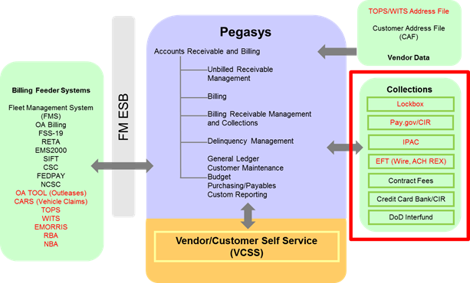
Phase 3 Collection Methods

Slide 13
Phase 3 Collection Methods (cont.)
Pegasys Cash Receipts (CR) documents recording Collections are created via the following methods in Phase 3:
Automatically via interfaces and Pegasys batch processing:
Manually entered, either stand alone or by copying forward from a Billing Document (BD)
IPACIN
Lockbox
Pay.gov via CIR
Non-IPAC
IPAC
Check, Cash, EFT (ACH REX and Wires), Lockbox, Pay.gov Donation
Manual Entry

Slide 14
Phase 3 Collection Methods (cont.)
The Collections course does not include detail regarding collections for IPAC or Debt Account/Claims as they are covered in other training courses
For detail information regarding their functionality, reference the following:
IPAC Collections: IPAC Lifecycle Training Course
Debt Account/Claims Collections: Debt Account Lifecycle Training Course

Slide 15
Dunning
Cash Receipt Introduction

Slide 16
Cash Receipts Overview
Cash Receipts – Billing Document Reference:
Collection of funds in Pegasys is recorded with Cash Receipt (CR) documents
Cash Receipts are used to record money received by GSA as payment for services rendered or goods provided
Cash Receipts are typically used to 1) reduce outstanding receivables and 2) record the collection of cash
When a CR references a Billing Document (BD), it liquidates the receivable balance recorded on the BD
Billing Document
Increases Receivable
Increases Revenue
CR References BD and Liquidates BD
Reduces Receivable
Reduces Revenue
Cash Receipt
Increases Cash
Increases Revenue
Notes:
Speaker Note: Collections are payments for services rendered or goods received and refunds from overpayments. In Pegasys collections are recorded with Cash Receipts.
Cash Increases Receivable Decreases,

Slide 17
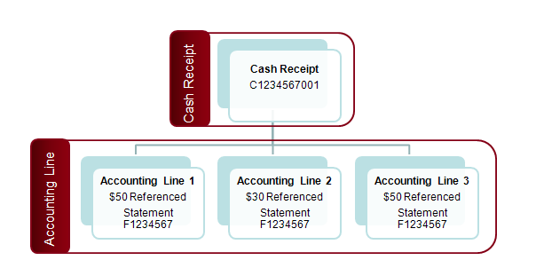
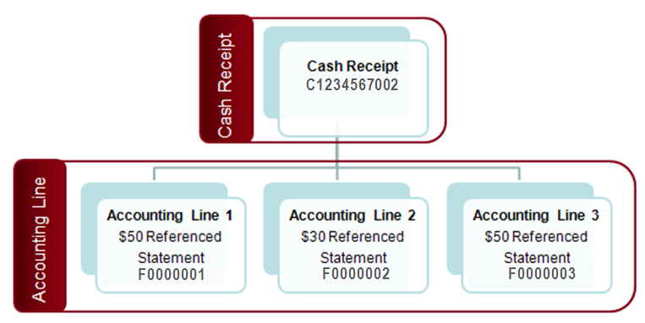
Cash Receipts Overview (cont.)
Cash Receipts:
Record both Normal and Advance collections from customers (as defined by the Line Type on the Accounting Line):
Normal
Advance Payment
Other purposes: advance offsets, credit application, credit refunds, write-offs, returned checks, chargebacks, etc. (also defined via Line Type)
Cash Receipts consist of one or more Accounting Lines
Cash Receipts with multiple accounting lines may reference:
Single Statement Number
Multiple Statement Numbers across accounting lines
Single Statement
Multiple Statements
Notes:
Speaker Note: Collections are payments for services rendered or goods received and refunds from overpayments. In Pegasys collections are recorded with Cash Receipts.
Cash Increases Receivable Decreases,

Slide 18
Cash Receipts – Referencing
Cash Receipts –Agreement Reference
Some Cash Receipts are received and recorded as an advance prior to services rendered or goods provided
Most Advance Cash Receipts reference an Agreement
When an Advance CR references an Agreement entity, it increases the advance balance recorded on the Agreement
Agreement Entity
CR References Agreement
Increases Advance Amount
Increases Collected Amount
Increases Unliquidated Advance Amount
Advance Cash Receipt
Increases Cash
Increases Liability
Notes:
Speaker Note: Collections are payments for services rendered or goods received and refunds from overpayments. In Pegasys collections are recorded with Cash Receipts.
Cash Increases Receivable Decreases,

Slide 19
Cash Receipts – Referencing (cont.)
Cash Receipts – Billing Document and Agreement Reference
Cash Receipts can also reference Billing Documents (BD) that reference an Agreement Entity
When a CR references a Billing Document (BD) that references an Agreement, it liquidates the receivable balance recorded on the BD
The CR also decreases the Unliquidated Receivable Amount on the Agreement entity while increasing the Collected Amount
Billing Document
Increases Receivable
Increases Revenue
CR References BD and Liquidates BD
Reduces Receivable
Reduces Revenue
CR References Agreement
Increases Collected Amount
Reduces Unliquidated Receivable Amount
Cash Receipt
Increases Cash
Increases Revenue
Notes:
Speaker Note: Collections are payments for services rendered or goods received and refunds from overpayments. In Pegasys collections are recorded with Cash Receipts.
Cash Increases Receivable Decreases,

Slide 20
Cash Receipt Processing Details
Cash Receipt Processing Details:
When GSA receives a payment from a Customer, GSA must immediately create a Cash Receipt in Pegasys to record the cash impact
Cash Receipts require that the user or the batch process specify:
Deposit Number
Accomplished Date
Dollar Amount
Transaction Type
Accounting Dimensions
Depending on the CR, Reference Document information should also be entered
On a Debit Voucher CR, a Debit Voucher Number is required
Notes:
If a check is received, the preferred method is to send the check to Lockbox before manual creation

Slide 21
Automatic & Manual CR Creation Details
Automation:
If the Cash Receipt is created by an automated processes, the pertinent details will be copied forward from the referenced Billing Document onto the CR
Manual:
There are three ways to manually create a Cash Receipts:
Stand-alone
Copy Forward from a Billing Document
Fully or partially liquidating a Billing Document
Copy From a separate Cash Receipt
Notes:
If a check is received, the preferred method is to send the check to Lockbox before manual creation

Slide 22
Phase 3 Business Line Collection Methods Overview
Business Line | Pay.gov | Lockbox | IPAC | Manual
R7 Outlease | X | X |  | X
Region 6 AAS | X | X | X | X
Region 6 ITS | X | X | X | X
Region 6 Claims | X | X | X | X
Region 7 Claims | X | X | X | X

Slide 23
Phase 3 Business Line Collection Methods Overview (cont.)
Business Line | Pay.gov | Lockbox | IPAC | Manual
R6 Manual : Integrated Acquisition Environment |  |  | X
R6 Manual: Interagency Council |  |  | X
R6 Manual : External Services | X |  | X | X
R6 Manual: Federal Citizen Services (FCS) & FCIC | X |  | X | X
R6 Manual: Great Seal of US | X |  | X | X
R6 Manual: Smart Buy | X |  |  | X
R6 Manual : TMVCS/Travel Training | X |  | X | X
R6 Manual: University for People (UFP) | X |  | X
R7 Manual: ITC | X | X | X | X
R7 Manual: Recycling | X | X |  | X

Slide 24
Phase 3 Cash Receipt Document Type Overview
CRs Introduced in Prior Phases:
New CRs Introduced in Phase 3:
Document Type | Uses
CH6, CH7 | Manual Checks
EF6, EF7 | Manual EFTs
CA6, CA7 | Manual Cash
IR6, IR7 | IPAC CRs
RC6, RC7 | Manual Returned Checks
DR6, DR7 | IPAC Debit Vouchers
CW6, CR6, CT6, CW7, CR7, CT7 | Credit Application CRs
WO6, WO7 | Write Off CRs
L6M | R6 Manual Lockbox
L6X | R6 Misc Lockbox
L6B, L6F, L7R | Business Line Lockbox
PC6, PC7 | Pay.gov via CIR
PA6 | Pay.gov (ACH)
PV6, PV7 | Pay.gov Refund
AO6, AO7 | Advance Offset
NW6, NW7 | Non-Federal Write Off
DDC | DoD Interfund
CC6, CV6, LC6, MC6 | Revenue Credit Card CRs
CIF, IFF | Contract Fees CRs
Document Type | Uses
PS6 | R6 SmartBuy Pay.gov
PE6 | R6 External Services Manual Pay.gov
L7M | R7 Misc Lockbox
L6L | R6 AAS & ITS Lockbox
IOF | Internal Offset
Notes:
Note: If a document type contains a number 6 or 7, it indicates that the document type is specific to the region (6 = Region 6 and 7 = Region 7). For example, Pay.gov Cash Receipt document types PC6 (which is handled by Region 6) and PC7 (which is handled by Region 7).

Slide 25
Segment 2:
Cash Receipt Document

Slide 26
Table of Contents
Segment 1: Collections Overview
Segment 2: Cash Receipt Documents
Cash Receipt Document Overview
Cash Receipt Line Types
Segment 3: Collections Query
Segment 4: Collections Processing
Segment 5: Collection Discrepancies
Segment 6: CIR Reconciliation
Segment 7: Collections Reports
Segment 8: Mass Import

Slide 27
Dunning
Cash Receipt
Document Overview

Slide 28
How do I navigate through a Cash Receipt?
Cash Receipts contain two main tabs that record the majority of pertinent information:
Header tab - frequently used fields:
a. Document Type
b. Document Number
d. Deposit Number
c. Status
e. Accomplished Date
f. Disbursing Office
g. External System ID
h. Assignment Code
Accounting Lines tab - frequently used fields:
g. Actg Dimensions (Revenue Source Code)
h. Tender Type
j. Agreement Number/Agreement Line Number
i. Document Reference Number/Line Number
k. TROR Classification/Collection Type
l. Cash Receipt Posting Order
a. Line Type
b. Transaction Type
d. Business Line
c. Receivable Type
e. Vendor Code
f. Line Amount

Slide 29
How do I navigate through a Cash Receipt (Cont.)?
Cash Receipts also contain the Charge Lines tab, which is a sub-tab of the Accounting Lines tab
Charge Lines tab – Record collections posting to Interest, Penalty, and Administrative Charges:
e. Line Amount
f. Accounting Template
a. Record Type
b. Line Number
c. Transaction Type

Slide 30
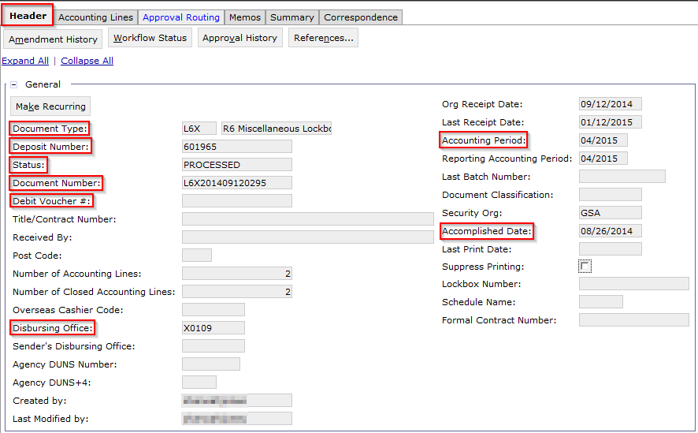
Cash Receipt Document: Header
Transactions > Accounts Receivable > New > Cash Receipt
Field | Description | Field | Description
Document Type | Corresponds to the document type configured for the type of CR entered, e.g. Pay.gov, Check, etc. | Accomplished Date | The date Treasury acknowledges the deposit actually occurred
Document Number | System-generated number unique to the document | Disbursing Office | Disbursing Office stored in Pegasys, e.g. GS187, X0109, etc.
Status | Statuses: New, Held, Scheduled, Rejected, Pending Approval, Cancelled, Processed | Debit Voucher Number | Populated on chargebacks and returned checks
Deposit Number | Deposit Ticket Number associated with the collection transaction | Accounting Period | Records period in which the transaction will post
Notes:
Speaker Notes:
Review/demo
Document Type: Direct users on how to search for Document types and where to find Doc types on the Configuration Spec
Document Number: (as covered in earlier slide)
Status: Explain Different Status’s the document can be in (New, Held, Scheduled, Rejected, Pending Approval, Cancelled, Processed)
Deposit number
Accomplished Date
Disbursing Office
Additional fields

Slide 31
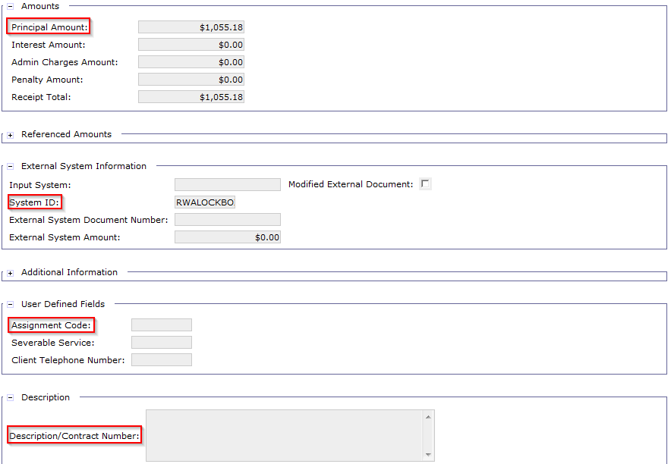
Cash Receipt Document: Header (cont.)
Field | Description | Field | Description
Principal Amount | Records the total amount of all accounting lines associated to the CR | Assignment Code | User defined text field used to tie the Finance assignee
External System ID | Identifies the external system through which the transaction was processed, e.g. RWALOCKBOX, R6PAYGOV, etc. | Description | Used to enter any additional identifiable information on the transaction
Notes:
Speaker Notes:
Principal Amount
External System ID: External ID is retrieved from the CIR Detail process. Explain in which instances users will see different external system ID’s
Assignment Code: User defined text field ties to the finance person that is assigned to deal with it (typically a 9 digit code)
Description

Slide 32
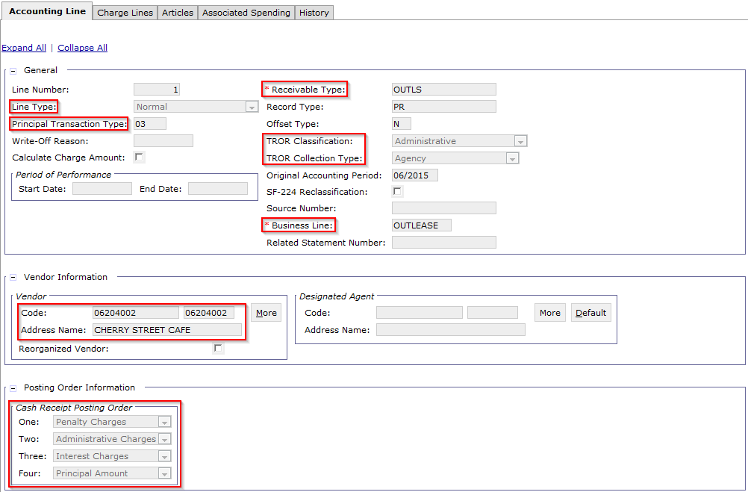
Cash Receipt Document: Accounting Line
Field | Description | Field | Description
Line Type | Used in conjunction with doc type and TT to define liquidations and journal postings | Business Line | Used to categorize CR documents, e.g. OUTLEASE, AASFEDSIM, etc.
Transaction Type | Used in combination with document type to infer General Ledger postings | TROR Classification | Values: Administrative, Direct Loan, Defaulted Guaranteed Loan, blank
Receivable Type | Used for flexible transaction definitions, e.g. EXTSERVNI, RITNI, etc. | TROR Collection Type | Indicates the collection type, e.g. Agency, Third Party, Treasury, blank, etc.
Vendor Code | Must be valid in Pegasys | CR Posting Order | IP&A will take priority over Principal Amount
Notes:
Line Type (the following sections will cover in detail the 4 different Line Types that GSA will be using: Normal, Debit Voucher, Advance and Advance Offset)
Transaction Type (give examples of trans types and when they are used)
Receivable Type (i.e. EXTSERVNI or RITNI)
TROR Classification/Collection Type
Business Line
Vendor Code – vendors depend on the business line
Cash Receipt Posting Order: defines the order which a Cash Receipt should liquidate the different line types of BDs (this is dictated by Treasury)

Slide 33
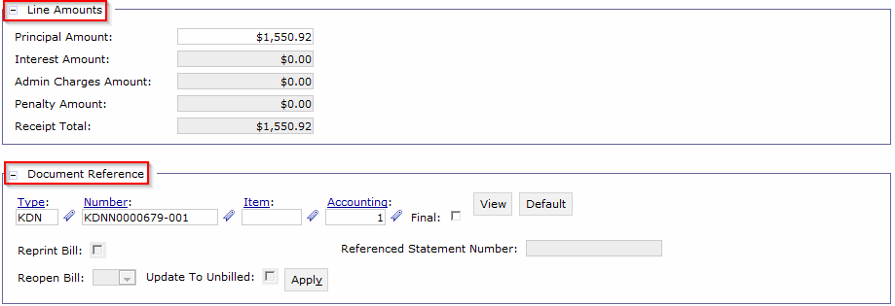
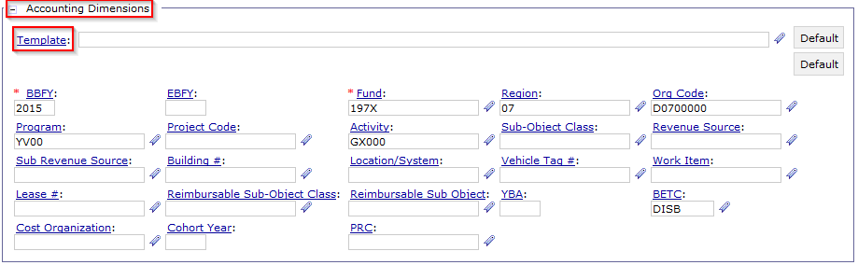
Cash Receipt: Accounting Line (cont.)
Field | Description | Field | Description
Line Amounts | Records principal amount & interest, admin, and penalty charges | Document Reference | BD or CR referenced by the document (if applicable)
Accounting Dimensions | Record’s document’s line of accounting | Agreement | Agreement and agreement line number referenced by the document (if applicable)
Notes:
Line Amounts
Document Reference – Billing Document, or another Cash Receipt (ex. Advance Offset or Refund)
Accounting Template - see the config guide for valid accounting templates
Revenue Source Code - will need to be entered by user (reference backed field)
Agreement section: most RWA/HOTD and Manual Business Line CRs will reference agreements

Slide 34
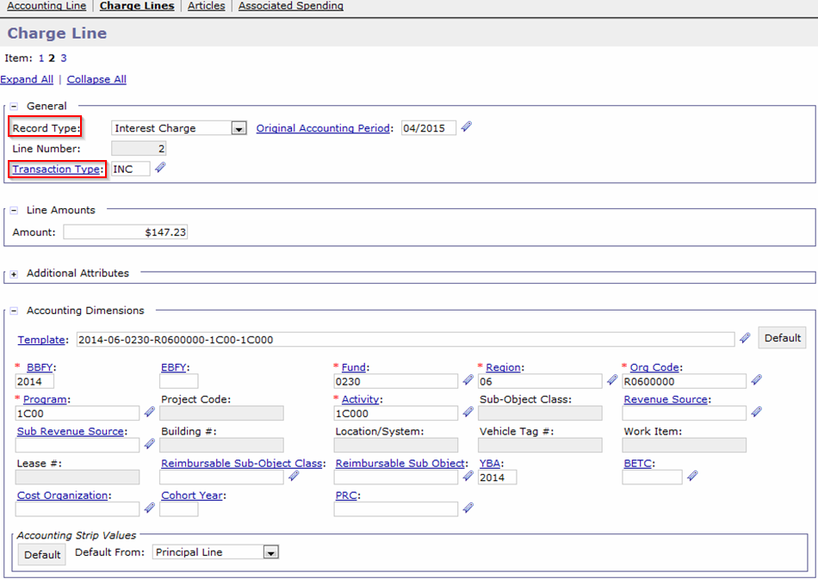
Cash Receipt: Charge Line
Field | Description | Field | Description
Record Type | Options: Interest Charge, Administrative Charge, Penalty Charge | Transaction Type | Used in combination with document type to infer postings to the General Ledger
Notes:
Speaker Notes:
Line Number is constant across all CRs:
Line 1 = Admin
Line 2 = Interest
Line 3 = Penalty
Charge Amount recorded in the Line Amounts section.
Transaction Type recorded (ADC, INC, PNC)
Accounting Dimensions

Slide 35
Cash Receipt: Adding an Attachment
GSA users can add attachments to CRs for internal use (Pegasys) and external use (VCSS)
The attachment is added directly to the CR document
Files containing PII data should not be added as an attachment
Steps to add an attachment:
Click the Attachments Button on the Pegasys document
Click the Import Local File button
Enter required and relevant fields
Select the Browse button and choose the file to attach
Select the Upload button
Select the Return button to Navigate back to the Cash Receipt Document
* | Newly created forms must first be Saved before a user can add an attachment
Notes:
Speaker Note: Please do not include images of a check as this is PII sensitive information.

Slide 36
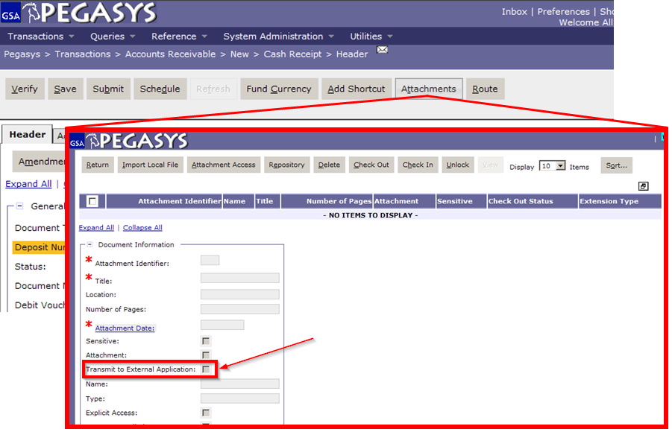
Cash Receipt: Adding an Attachment
Flag indicating if attachment is transmitted externally to VCSS
Notes:
Speaker Note: Click attachments button. This is what screen looks like when you do.
Speak Note: Attachment Date is date attachment is added to the Form or Document.

Slide 37
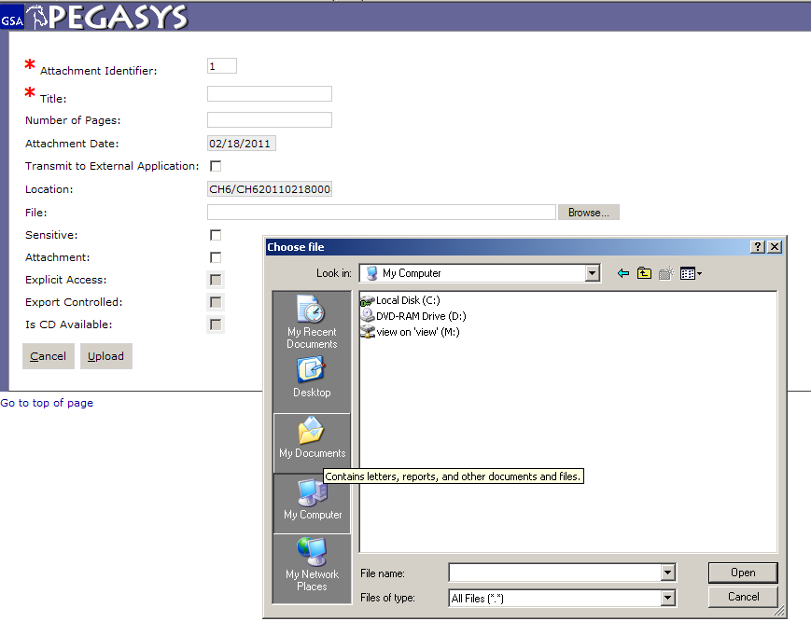
Cash Receipt: Adding an Attachment
Notes:
Fill in required fields (marked with astrix), click Browse. Pop up window comes up. choose file, click open. When finished, click Upload

Slide 38
Cash Receipt: Correspondence Overview
Correspondence supports:
Communication between GSA and customers using Pegasys and VCSS
Ability to add attachments to the correspondence record
Correspondence provides GSA with the ability to:
Initiate communication with the customer
Record and track customer communication
Respond to customer communication
Two Sources of Correspondence:
VCSS: Customer initiated
Pegasys: GSA user-entered correspondence
Notes:
Speakers Note: Correspondence can only be sent to registered customers.

Slide 39
Cash Receipt: Correspondence Overview
Cash Receipt Correspondence
Correspondence specifically related to a payment or collection in the financial system
Can be created for, associated with, and viewable from Cash Receipt documents
Optionally, correspondence can be emailed and/or transmitted to VCSS for registered customer to see
Notes:
Speakers Note: The last bullet only applies for registered customers.

Slide 40
Correspondence: Adding Doc Correspondence
Steps to create Document Level Correspondence on a Cash Receipt:
Open the Cash Receipt document in View mode
Navigate to the Correspondence tab
Click Add
Select the newly added Correspondence record
Enter applicable fields:
Click Save
First Name (Contact Person) | Public Publishing
Last Name (Contact Person) | Correspondence
Communication Source | Accounting Line Number
Type of Correspondence | Itemized Line Number
* | Newly created forms must first be Saved before a user can enter Correspondence
Notes:
Speaker Note: You can add correspondence in view, correct or amend. You can also add correspondence when a document is originally created as long as the form is SAVED first!!
Field values generated upon saving:
Creator: The user ID of the person that created the record.
Created Date: The date correspondence was first entered.
Record Number: The sequential number given to the correspondence record upon saving.
Last Modified By: ID of person who last made an update to the record.
Last Modified Date: Date record was last modified
Additional Info on fields:
Assignment Code: The code used to identify the GSA user responsible managing the Cash Receipt.
Type of Correspondence: A drop down box containing correspondence types (Null, Resolution, Communication, Question, Chargeback, Chargeback - Resolution, Dispute and Other).
Communication Source: Dropdown: (External System, Phone, Fax, Mail/Email, VSS)
Public Publishing: Specifies if the correspondence record should be transmitted to VSS for public viewing. Defaults to False.
Correspondence: Free form space provided for the user to enter the text to convey to the intended recipient.

Slide 41
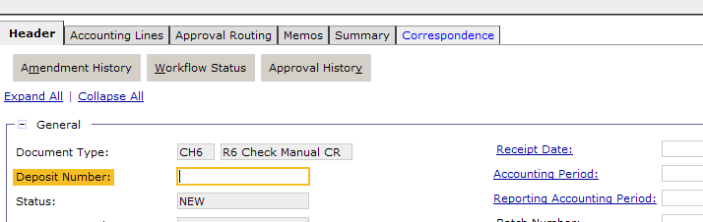
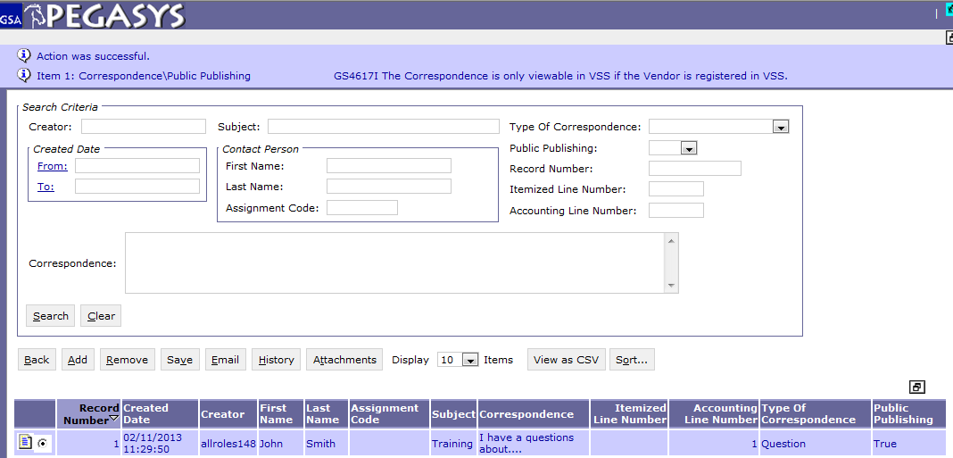
Cash Receipt: Adding Document Level Correspondence
Notes:
Click correspondence tab. This is what screen looks like. Show Back, Add, Save buttons.

Slide 42
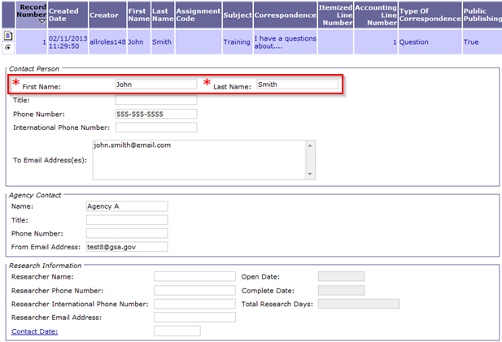
Cash Receipt: Adding Document Level Correspondence
Users may enter any relevant correspondence information, e.g. Name, Type of Correspondence, Subject, etc.
Public Publishing flag: If checked, the correspondence will be transmitted to VCSS for public viewing
Field Name | Description
First Name/Last Name | The name of the individual initiating the correspondence.
Notes:
Show fields for correspondence:
Creator
Created From/To Date
Subject
Contact Person First Name
Contact Person Last Name
Assignment Code
Type of Correspondence
Public Publishing
Record Number
Correspondence
Accounting Line Number
Itemized Line Number

Slide 43
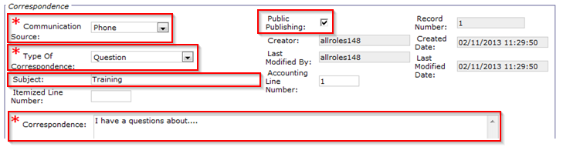
Cash Receipt: Adding Document Level Correspondence
Field Name | Description
Communication Source | Options include: External System, FAX, Mail or Email, and Phone
Type of Correspondence | Options include: Resolution, Communication, Question, Chargeback, Chargeback Resolution, Dispute, and Other.
Subject | The subject header used to describe the correspondence.
Correspondence | Text field used to enter any text/information relating to the correspondence record.
Public Publishing Flag | Correspondence record is viewable in VCSS when set equal to True. Debt Account Correspondence will not be transmitted to VCSS.
Notes:
Show fields for correspondence:
Creator
Created From/To Date
Subject
Contact Person First Name
Contact Person Last Name
Assignment Code
Type of Correspondence
Public Publishing
Record Number
Correspondence
Accounting Line Number
Itemized Line Number

Slide 44
Cash Receipt: Amendment vs. Correction
Cash Receipts can be Amended or Corrected as necessary using the:
Form/Document Selection Query
Collections Query
Cash Receipts should NOT be cancelled!!
Instead, GSA processes dictate reducing a Cash Receipt down to $0 by:
Amending a Processed Cash Receipt to $0
Correcting a Rejected or Held Cash Receipt to $0

Slide 45
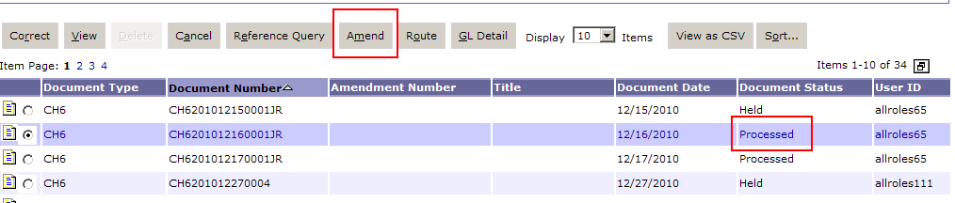
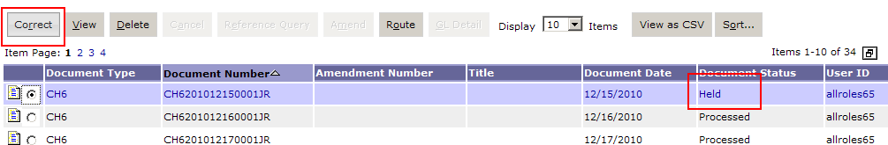
Cash Receipt: Amendment vs. Correction
Form/Document Selection
Transactions > Form/Document Selection
Amend Cash Receipts in Processed Status
Correct Cash Receipts in Rejected or Held Status
Notes:
Amend is used to record Amendment history on the document.

Slide 46
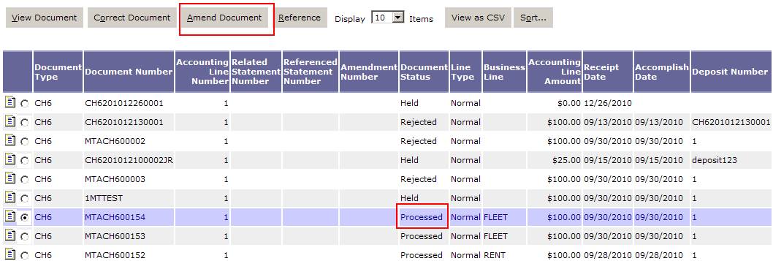
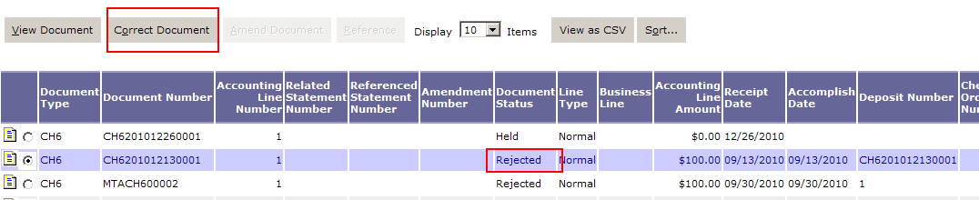
Cash Receipt: Amendment vs. Correction
Collections Query
Queries > Accounts Receivable > Collections
Amend collections in Processed Status
Correct collections in Rejected or Held Status

Slide 47
Dunning
Cash Receipt Line Types

Slide 48
Cash Receipt: Normal Line Type
CR Normal Line Type is used to:
Record the increase to the cash balance associated with the collection
Record the decrease to the receivable balance associated with the referenced Billing Document
Cash Receipt with a Normal Line Type should be processed when GSA gets paid for providing a good or service
Cash Receipt Line Type = Normal
The majority of GSA Cash Receipts will be recorded with Normal Line Type
Cash Receipts with a Normal Line Type referencing a Billing Document:
Liquidate the receivable balance in the amount of the Cash Receipt on the Billing Document
Notes:
CR referencing BD diagram on following slide

Slide 49
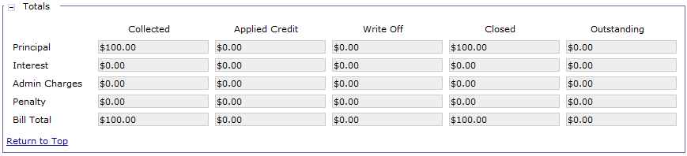
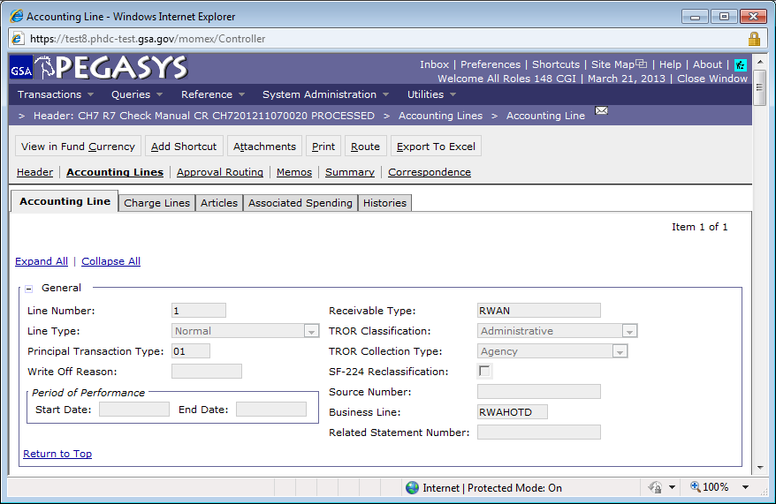
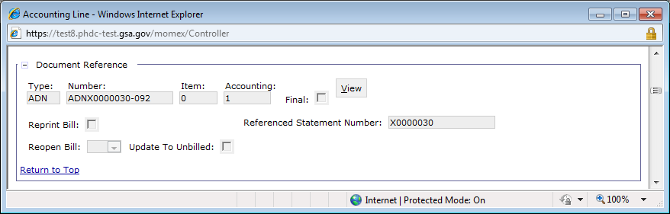
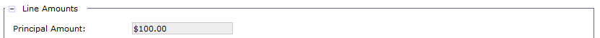
Cash Receipt: Normal Line Type (cont.)
When a CR (Normal Line Type) references a BD, the following occurs:
Liquidates BD
Reduces Receivable
Billing Document
Billing Document
Increases Receivable
Increases Revenue
Cash Receipt
Increases Cash
Increases Revenue
Cash Receipt
CR References BD
and Liquidates BD
Reduces Receivable
Reduces Revenue

Slide 50
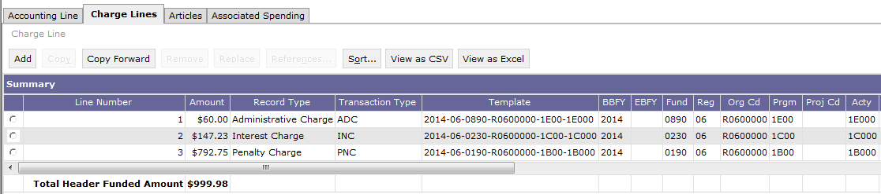
Cash Receipt: Normal Line Type w/Charge Lines
CR Normal Line Type may also possess associated Charge Lines:
Record the increase to the cash balance associated with the collection
Record the decrease to the receivable balance associated with the referenced Billing Document’s Charge Lines
Cash Receipt Charge Line Record Types:
Administrative Charge
Interest Charge
Penalty Charge
Note: If the referenced document contains outstanding IP&A, the generated CR should liquidate IP&A first, prior to liquidating the principal amount
Notes:
CR referencing BD diagram on following slide

Slide 51
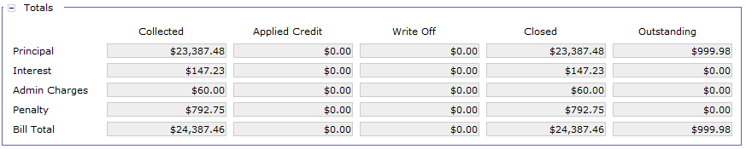
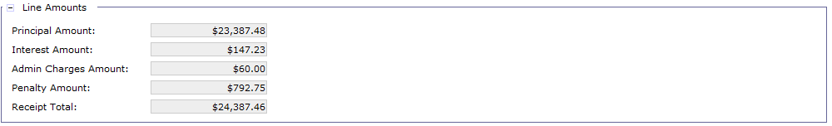
Cash Receipt: Normal Line Type w/Charge Lines (cont.)
When a CR (Normal Line Type) references a BD and contains associated Charge Lines, the following occurs:
Liquidates BD’s IP&A Charge Lines
Reduces Outstanding IP&A Receivable
Billing Document
Increases Receivable
Increases Revenue
Billing Document
Cash Receipt
Increases Cash
Increases Revenue
Cash Receipt
CR References BD
and Liquidates BD
Reduces Receivable
Reduces Revenue

Slide 52
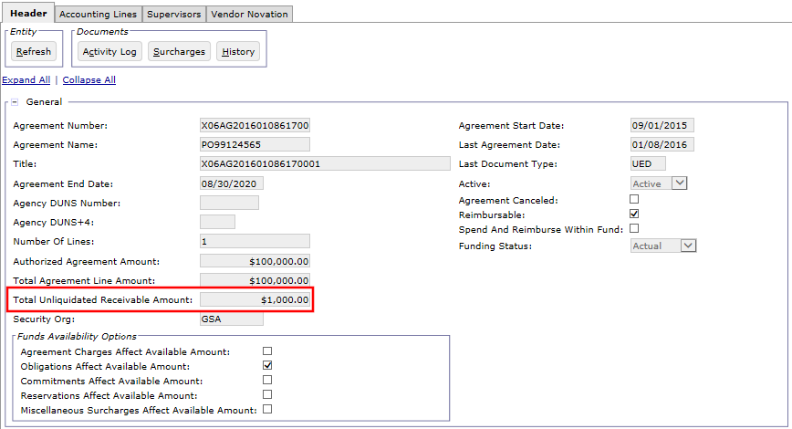
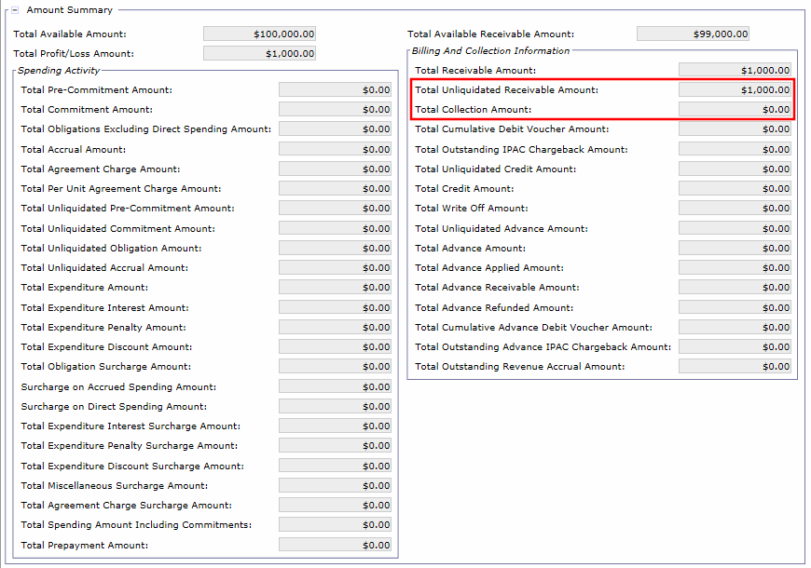
Cash Receipt: Normal Line Type – Agreement Entity
Agreement Entity before Collection:
Agreement created for $100,000
Customer was billed $1,000 and processed against the Agreement
Next step is to process the collection

Slide 53
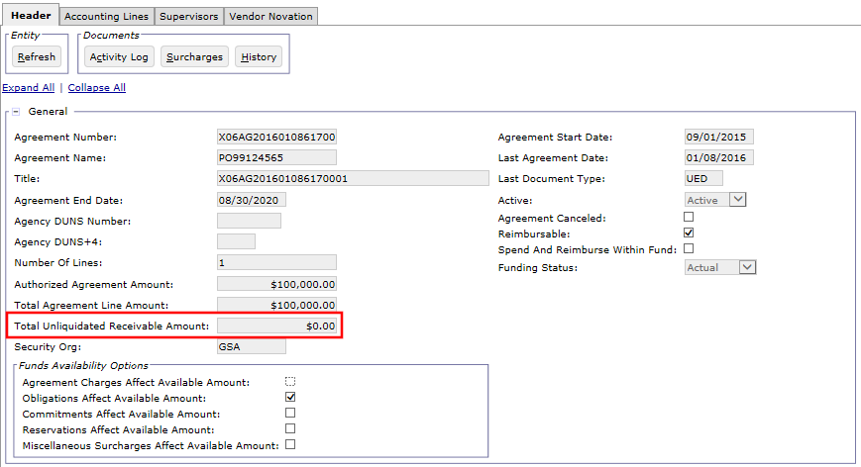
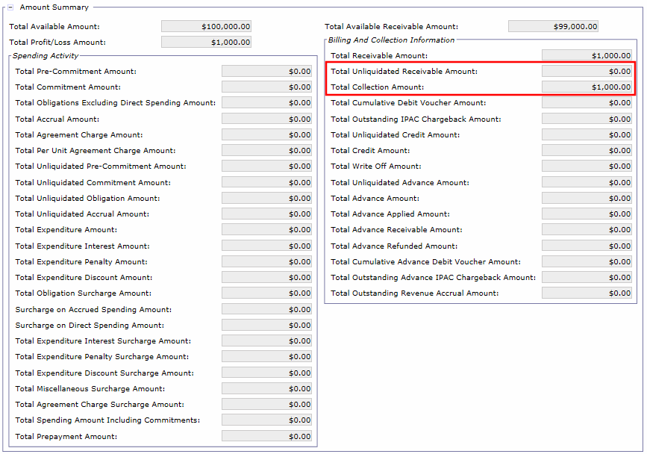
Cash Receipt: Normal Line Type – Agreement Entity
Agreement Entity after Collection:
Total Unliquidated Receivable Amount is reduced by collection amount
Total Collection Amount is increased by collection amount
Notes:
Changes to the Agreement Entity after collection from the customer.

Slide 54
Exercise
Exercise 1: Create a Normal Line Cash Receipt

Slide 55
Cash Receipt: Debit Voucher Line Type
Debit Voucher CRs are used to reduce the cash balance originally posted by a previous collection under the following circumstances:
Bounced Check
Purchaser did not have sufficient funds in their account to cover the check
GSA's cash balance should be reduced by the amount of the bounced check
Chargeback
A customer disputes previously submitted Pay.gov collections
Process described further in Segment 4: Collections Processing: Pay.gov
Refund
GSA processes a refund (for an overpayment) via Pay.gov
Process described further in Segment 4: Collections Processing: Pay.gov
Notes:
This is a basic example of the document chain typically involved in the issuance of a debit voucher. The Original Cash Receipt is referenced (Copy forward from) to the BD, partially or fully liquidating it. The Debit Voucher is then referenced to the CR (copy forward from) to return the funds to the BD. All of the documents are linked in the system through the references/relationships they share.

Slide 56
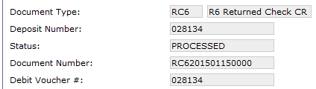
Cash Receipt: Debit Voucher Line Type (cont.)
The original Cash Receipt that liquidated the bill should be referenced on the Debit Voucher CR
Note: the Billing Document is NOT the reference on the Debit Voucher CR
Since the original Cash Receipt references the closed Billing Document line, Pegasys re-opens the Bill’s outstanding amount
Line Type = Debit Voucher – Normal
Treasury provided Debit Voucher Number recorded on CR Header tab
Distinct GSA Debit Voucher document types:
RC6 & RC7 (R6/R7 Returned Check Debit Voucher)
PV6 & PV7 (R6/R7 Pay.gov Refund Debit Voucher)
DR6, DA7, & DR7 (R6/R7 IPAC Chargeback Debit Voucher)
CV6 (R6 Revenue Credit Card Debit Voucher)
Notes:
The Debit Voucher Number is provided by Treasury (regardless if it is systematically entered via batch processing or manually entered).
If manually processed, the Debit Voucher Number must be entered in accordance with the detail information provided by the cash group when appropriate to avoid Unbooked cash.

Slide 57
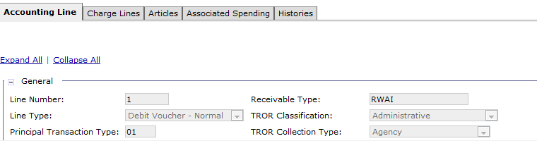
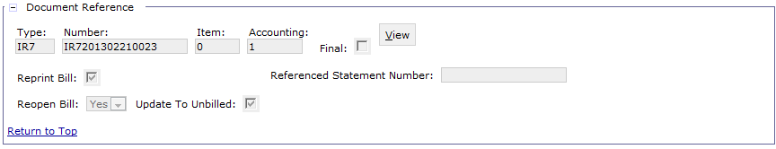
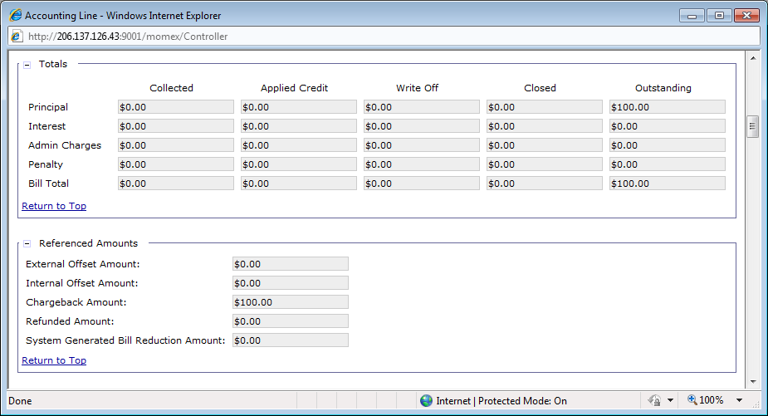
Cash Receipt: Debit Voucher Line Type (cont.) Updates to Billing Document
Debit Voucher Cash Receipt
($100.00)
References original CR document
Billing Document
The Collection Amount is drawn down and the Outstanding Amount is increased by the Amount on the Debit Voucher CR
The Chargeback Amount is increased by the Amount of the Debit Voucher CR
Notes:
DB CR references the original CR. The original CR references the Billing Document.

Slide 58



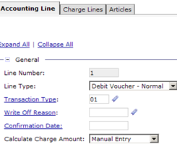
Cash Receipt: Debit Voucher Example
1
2
Customer Billed
Payment Received - The Cash Receipt closes the bill
by liquidating its outstanding amount
BD $100
-$100 (liquidated)
$0
Billing Document
Line Type: Normal
$100
Cash Receipt
Line Type: Normal
$100
3
Check Bounces
4
Manual creation of Debit Voucher CR
Insufficient funds prohibit cash being received by GSA
A ($100) Debit Voucher CR must be processed referencing the original CR (step 2)
This action will go up the doc chain and re-open the referenced bill for $100 to correctly portray an unpaid bill
BD $100
(re-opened)
VOID
CR $100
Type: Normal
CR ($100)
Type: Debit Voucher

Slide 59
Cash Receipt: Debit Voucher Manual Creation
Overview of manually creating a Non-IPAC Debit Voucher:
Create a new CR with a Debit Voucher Document Type
Copy Forward the associated normal Cash Receipt
Enter the required fields on the Header tab
Debit Voucher Number
Accomplished Date
Enter the required fields on Accounting Line:
Line Type = Debit Voucher - Normal
Transaction Type = 01
Principal Amount = Negative value (amount in parentheses)
Notes:
Clarify the difference between copy forward and copy from
Copy From: copies information from an existing document into a new form of the same type
Copy Forward: copies information from an existing document into a new form which is next in succession in the document chain
Doc chain = BD > CR normal > CR Debit Voucher

Slide 60
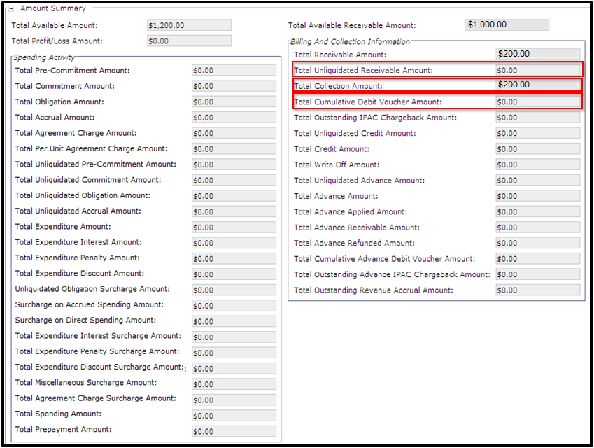
Cash Receipt: Debit Voucher Line Type
Agreement Entity Before Debit Voucher:
Total Unliquidated Receivable Amount = $0
Total Collection Amount = $200
Total Cumulative Debit Voucher Amount = $0

Slide 61
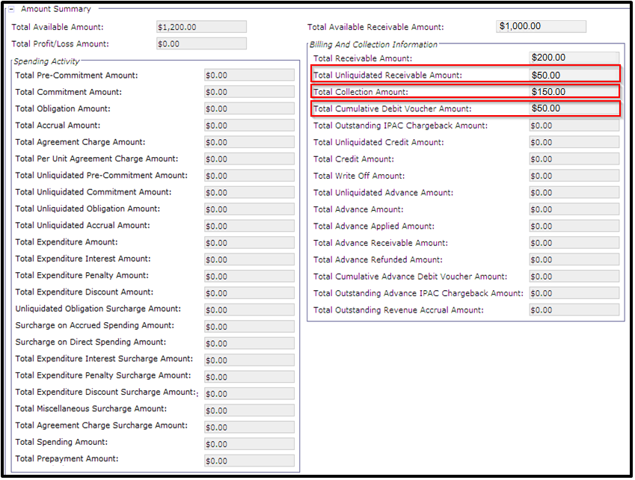
Cash Receipt: Debit Voucher Line Type
Agreement Entity After Debit Voucher:
Total Unliquidated Receivable Amount = $50
Total Collection Amount = $150
Total Cumulative Debit Voucher Amount = $50

Slide 62
Advance Bills, Collections, and Offsets
Disclaimer: Applicable to AASFEDSIM and ITSEXPSER business lines only
When an Agreement is established with a Non-Federal customer, GSA must wait for the customer to provide a monetary Advance before the customer order can be filled
Advance Collections
Processed prior to GSA starting to fill the customer order (for work that has not yet been performed)
Required for non-Federal customers before spending can process against agreement
Can be received:
For both non-Federal and Federal customers
Prior to or after creation of PCAS Agreement
Tracks “prepayment” as a liability via Cash Receipt because GSA has not yet filled the customer order or “earned” the prepayment
After customer order has been filled, GSA processes Advance Offset Cash Receipt
Records earned revenue
Liquidates liability originally posted by Advance Payment

Slide 63
Advance Bills, Collections, and Offsets
Agreement with Federal Customer – does not require an advance collection:
Agreement created in Pegasys
ED: External Agreement
Bill generated from DBR
BD: Normal Line Type
Collection received from customer
CR: Normal Line Type

Slide 64
Advance Bills, Collections, and Offsets
Agreement with non-Federal Customer – requires an advance collection:
Agreement created in Pegasys
ED: External Agreement
Bill generated from advance DBR
BD: Advance Line Type
Advance collection received from customer
CR: Advance Pmt Line Type
Goods/services provided to customer triggers new offset notification DBR
Offset Notification BD generated from offset DBR notifies Finance
BD: Normal Line Type
Advance Collection is offset; Advance Notification BD closed
CR: Advance Offset and Normal Line Types

Slide 65
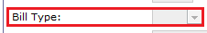
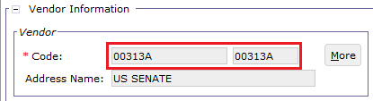
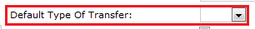
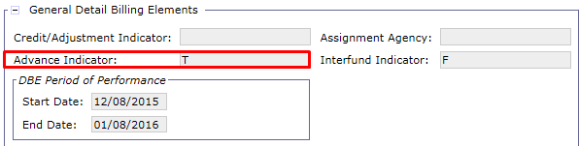
Advance DBRs
Advance Detail Billing Records
Generated for those customers who are required to provide advances
Are non-IPAC by definition
Accounting Elements DBR tab
Bill Type = blank
Vendor = non-IPAC vendor
Detail Billing Element Fields tab
Advance Indicator: T
Address Level Vendor

Slide 66
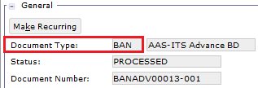
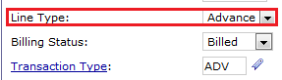
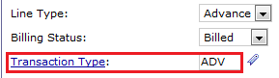
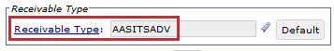
Advance Billing Document
Document Type: BAN
Line Type: Advance
Transaction Type: ADV
Receivable Type: AASITSADV

Slide 67
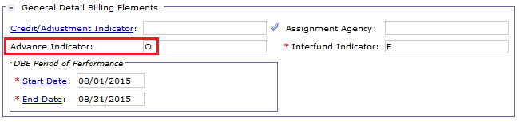
Advance Offset DBRs
Advance Detail Billing Records
Generated for those customers who are required to provide advances
Are non-IPAC be definition
Accounting Elements DBR tab
Bill Type = blank
Vendor = non-IPAC vendor
Detail Billing Element Fields tab
Advance Indicator: O
Address Level Vendor

Slide 68
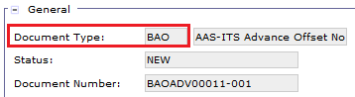
Advance Offset Billing Document
Document Type: BAO
Line Type: Advance
Transaction Type: ADV
Receivable Type: AASITSADV

Slide 69
Billing Document – Advances – Document Types
Billing Vehicle: DBR/PCAS Hybrid
Business Line | Document Type | Name
AASFEDSIM ITSEXPSER | BAN | AAS-ITS Advance BD
AASFEDSIM ITSEXPSER | BAO | AAS-ITS Advance Offset Notification BD

Slide 70
Advance Billing and Collections
Agreement with non-Federal Customer – requires an advance collection:
Agreement created in Pegasys
ED: External Agreement
Bill generated from advance DBR
BD: Advance Line Type
Advance collection received from customer
CR: Advance Pmt Line Type
Goods/services provided to customer triggers new offset notification DBR
Offset Notification BD generated from offset DBR notifies Finance
BD: Normal Line Type
Advance Collection is offset; Advance Notification BD closed
CR: Advance Offset and Normal Line Types

Slide 71
Advance Billing
RBA/NBA feeder system transmits advance DBR to Pegasys to trigger creation of advance customer billing
DBR Advance Indicator: T (True/Advance)
Advance DBR is imported/crosswalked/summarized to create advance Billing Document
Advance Billing Document Header:
Document Type: BAN
Waive Admin Charges: True (checked)
Waive Penalty Charges: True (checked)
Waive Interest on Principal: True (checked)
Advance Billing Document Accounting Line:
Line Type: Advance
Transaction Type: ADV (null post)
Billing Status: Unbilled
Receivable Type: AASITSADV
Dunning Print flag: False (unchecked)
Revenue Source Code: Null (not applicable)
Agreement Number and Agreement Line Number reference

Slide 72
Advance Billing – DBR Advance Indicator
Advance Indicator: T

Slide 73
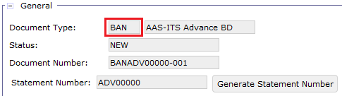
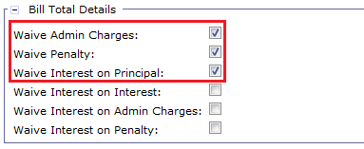
Advance Billing – Billing Document Header
Document Type: BAN
Waive Admin Charges: True (checked)
Waive Admin Charges: True (checked)
Waive Interest on Principal: True (checked)

Slide 74
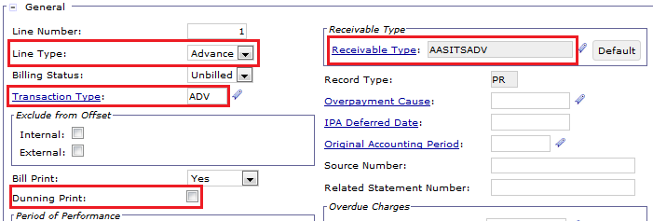
Advance Billing – Header Accounting Line
Line Type: Advance
Billing Status: Unbilled
Transaction Type: ADV
Receivable Type: AASITSADV
Dunning Print flag: False (unchecked)

Slide 75


Advance Billing – Header Accounting Line
Revenue Source Code: null
Agreement Number and Agreement Line Number

Slide 76
Advance Billing – Correcting Generated Forms
Advance Billing and Advance Offset Notification BDs generated by Summarization are Rejected due to the following:
Business Line is required
Revenue Source Code should not be specified
BAN/BAO documents do NOT recognize revenue
After Summarization, Finance users will correct the Rejected BAN/BAO forms to:
Populate the Business Line value with the appropriate code
Remove the Revenue Source Code

Slide 77

Advance Billing
ARBILLGEN is run to generate an advance bill PDF, which is sent to the customer
Updates Billing Status from Unbilled to Billed
Transaction Type: ADV (null post)

Slide 78
Advance Collection
The customer remits payment, processed as an advance Cash Receipt
The collection amount is processed as a liability because GSA has not yet filled the customer order
Advance collections are processed using a Cash Receipt document with:
Advance Cash Receipt Header:
Document Type: varies based on collection method
Advance Cash Receipt Accounting Line:
Transaction Type: A4
Line Type: Advance Payment
Revenue Source Code: null
Agreement Number and Agreement Line Number reference
Advance BD Document Number and Accounting Line Number reference
Advance collections update the following PCAS Agreement buckets:
Total Collection Amount
Total Advance Amount
Total Unliquidated Advance Amount

Slide 79

Advance Collection – Header Accounting Line
Line Type: Advance Payment
Transaction Type: A4

Slide 80


Advance Collection – Header Accounting Line
Revenue Source Code: blank
Referenced Document Type, Document Number, and Accounting Line Number of Advance Billing Document
Agreement Number and Agreement Line Number

Slide 81

Agreement Entity – Before Advance Collection
Agreement is created for $1,000
Advance BD created for $100
The next step would be for the customer to send an advance payment so GSA can begin filling the order
Notes:
Agreement was created for $1,200. Before work could begin, the customer is required to send in advance.

Slide 82

Agreement Entity – After Advance Collection
Advance collection is processed for $100
The Total Collection Amount increases by the Advance
The Total Unliquidated Advance Amount increases by the Advance
The Total Advance Amount increases by the Advance
Notes:
Agreement was created for $1,200. Before work could begin, the customer was required to send in advance, which they did for $600.

Slide 83
Advance Offset Notifications and Offsets
Agreement with non-Federal Customer – requires an advance collection, followed by an offset:
Agreement created in Pegasys
ED: External Agreement
Bill generated from advance DBR
BD: Advance Line Type
Advance collection received from customer
CR: Advance Pmt Line Type
Goods/services provided to customer triggers new offset notification DBR
Offset Notification BD generated from offset DBR notifies Finance
BD: Normal Line Type
Advance Collection is offset; Advance Notification BD closed
CR: Advance Offset and Normal Line Types

Slide 84
Advance Offset Notification DBR/BD
The goods/services are delivered to the customer, triggering RBA/NBA feeder system to send a 2nd DBR, called the advance offset notification DBR
DBR Advance Indicator: O (advance offset)
Advance Offset DBR is imported/crosswalked/summarized to create advance Notification Billing Document
Advance Offset Notification Billing Document Header:
Document Type: BAO
Waive Admin Charges: True (checked)
Waive Penalty Charges: True (checked)
Waive Interest on Principal: True (checked)
Advance Offset Notification Billing Document Accounting Line:
Line Type: Normal
Transaction Type: ADO (null post)
Billing Status: Billed
Receivable Type: AASITSADV
Bill Print: No
Dunning Print flag: False (unchecked)
Revenue Source Code: Null (not applicable)
Agreement Number and Agreement Line Number reference

Slide 85
Advance Offset Notification – DBR Advance Indicator
Advance Indicator: O

Slide 86

Advance Offset Notification – Billing Document Header
Document Type: BAO
Waive Admin Charges: true (checked)
Waive Admin Charges: true (checked)
Waive Interest on Principal: true (checked)

Slide 87

Advance Offset Notification – Billing Document Header Accounting Line
Line Type: Normal
Billing Status: Billed
Transaction Type: ADO
Receivable Type: AASITSADV
Bill Print: No
Dunning Print flag: false (unchecked)

Slide 88
Advance Offset Notification – Billing Document Header Accounting Line
Revenue Source Code: null
Agreement Number and Agreement Line Number

Slide 89
Advance Offset Cash Receipt
GSA Finance manually creates a new Advance Offset AO6 CR with the following
Advance Offset Cash Receipt Header:
Document Type: AO6
Advance Offset Cash Receipt Accounting Line 1:
Line Type: Advance Offset
Transaction Type: 01 (posts revenue)
Revenue Source Code: varies based on Business Line
AASFEDSIM – NBA1
ITSEXPSER – RBA1
Agreement Number and Agreement Line Number reference
Document Number and Accounting Line Number reference: Advance Payment CR
Advance Offset Cash Receipt Accounting Line 2:
Line Type: Normal
Transaction Type: 03 (null post)
Revenue Source Code: Null
Agreement Number and Agreement Line Number reference
Document Number and Accounting Line Number reference: Advance Offset Notification BD

Slide 90

Advance Offset Cash Receipt – Header
Document Type: AO6

Slide 91

Advance Offset Cash Receipt – Header Accounting Line 1
Line Type: Advance Offset
Transaction Type: 01

Slide 92


Advance Offset Cash Receipt – Header Accounting Line 1
Revenue Source Code: varies based on Business Line
NBA1 for AASFEDSIM
RBA1 for ITSEXPSER
Referenced Document Type, Document Number, and Accounting Line Number of Advance Collection Cash Receipt
Agreement Number and Agreement Line Number

Slide 93

Advance Offset Cash Receipt – Header Accounting Line 2
Line Type: Normal
Transaction Type: 03

Slide 94

Advance Offset Cash Receipt – Header Accounting Line 2
Revenue Source Code: blank
Referenced Document Type, Document Number, and Accounting Line Number of Advance Offset Notification Billing Document
Agreement Number and Agreement Line Number

Slide 95
Advance Offset Cash Receipt – Agreement Updates
Advance Offset Cash Receipts update the following PCAS Agreement buckets:
Total Profit/Loss Amount
Total Available Receivable Amount
Total Unliquidated Advance Amount
Total Advance Applied Amount

Slide 96

Agreement Entity – Before Advance Offset

Slide 97

Agreement Entity – After Advance Offset
After Advance Offset Cash Receipt of $100

Slide 98
Exercise 2.1
Exercise 2.1 – Create and Advance Collection Cash Receipt

Slide 99
Exercise 2.2
Exercise 1.2.2 – Create an Advance Offset Collection Cash Receipt

Slide 100
Segment 3:
Collections Query

Slide 101
Table of Contents
Segment 1: Collections Overview
Segment 2: Cash Receipt Documents
Segment 3: Collections Query
Collections Query Functionality
Segment 4: Collections Processing
Segment 5: Collection Discrepancies
Segment 6: CIR Reconciliation
Segment 7: Collections Reports
Segment 8: Mass Import

Slide 102
Dunning
Collections Query
Functionality

Slide 103
Collections Query – Search Criteria
The Collections query provides GSA a single place to obtain information regarding all collections
General Key Search Fields
Document Type/Number
Document Status
Vendor Info
Accounting Dimensions
Collection Specific Key Search Fields
Line Type (Normal, Advance, etc.)
Applied or Unapplied collections
Input System (Lockbox, Pay.gov, etc.)
Business Line
Check Number
Users with the appropriate Collections role have the capability to amend/correct the document from the query
Amend is used on Processed CRs
Correct is used on Held/Rejected CRs Forms
Document Date
Statement Number
Accounting Line Number
Deposit Number
Receivable Type
Agreement Number

Slide 104

Collections Query – Search Criteria
Queries > Accounts Receivable > Collections Query
Field | Description
Document Type/Number/Actg. | Allows users to search for a specific collection document type, document number, or accounting line number
Accounting Line Amount | Line amount range, e.g. $10.00-$14.99
Accomplished Date | Search by Accomplished Date on collection header
Business Line | Search by Business Line recorded on the collection accounting line
Line Type | Recorded on the collection accounting line; allows users to limit search for certain types of transactions, e.g. a user is only searching for advance offsets
Document Status | Search for collection documents by document status, e.g. Processed, Held, Rejected, etc.
Notes:
Discuss search parameters:
All parameters highlighted in red are fields that are unique to the Collections Query (not on the Form/Doc Query)

Slide 105

Collections Query – Search Criteria
Various additional search criteria are available on the Collections Query, including:
Field | Description
Applied to Billing Document/Debt Account | Allows users to search for unapplied collections only
Reference Document | Specific a specific document type/number/accounting line
External System ID | Search for collections received from a particular external system
Receivable Type | Corresponds to the Receivable Type recorded on the collection accounting line
Vendor Code | Corresponds to vendor recorded on the collection document
Bill Type | IPAC or Standard bill
Check/Money Order Number | Check Number recorded on CR Header
Notes:
Discuss additional criteria and vendor search (i.e. Reference document information, External System ID, Vendor Code etc.)
Applied to billing Criteria: Users can search for applied or unapplied collections with this.
Bill Type: IPAC or Standard

Slide 106

Collections Query – Search Criteria
Users may also search for collections using a variety of User Define fields, as well as specific accounting dimensions:
Field | Description | Field | Description
Header UDF | Specific to the User Defined Fields/values recorded on the collection’s header | Accounting Line UDF | Specific to the User Defined Fields/values recorded on the collection’s accounting line
Notes:
Discuss additional criteria and vendor search (i.e. Reference document information, External System ID, Vendor Code etc.)
Applied to billing Criteria: Users can search for applied or unapplied collections with this.
Bill Type: IPAC or Standard

Slide 107


Collections Query – Item Collection
The ‘Reference’ button allows users to view the reference chain associated to the collection
Returns the Referenced BD info
Notes:
Through the collections query, users can not only view Cash Receipt documents, but also the Billing documents/Cash Receipts/Debt Accounts they are referenced to. To open the reference, select the record and click the Reference button.

Slide 108






Collections Query: Scenarios
Example scenarios of when the Collections Query would be used:
The user knows the accounting line amount is around $75 so they search for an amount range of $70-$80
A user needs to find all collections that were not successfully applied to a Billing Doc during the prior nights import process
A user is searching for a specific Accounting Line Number
GSA fulfilled a service that was paid for in Advance, and a user wants to search for the Advance Payment in order to reference it on the Advance Offset CR
A user wants to find all Rejected IPAC collections
A user is looking for Lockbox collections referencing a particular Business Line
Notes:
Box 1: In the Form/Doc select query, an amount range can be entered but it’s not line specific like on the Collections Query.

Slide 109






Collections Query: Scenarios (Cont.)
Example scenarios of when the Collections Query would be used:
A user is searching for collections received from a particular Input System, e.g. ECP – Lockbox, Pay.gov, etc.
A user wants to query for any Returned Checks processed in the past month to search for re-opened bills
The user is querying for Held collections referencing a particular agreement
A user needs to query for a collection document using the Debit Voucher Number
The user is querying for all Credit Application funds returned to Treasury using doc type CT6/CT7
A GSA user would like to query all processed collections referenced to an individual statement number
Notes:
Box 1: In the Form/Doc select query, an amount range can be entered but it’s not line specific like on the Collections Query.

Slide 110

Collections Query: Scenarios (Cont.)
Region 7 Outlease Lockbox Advance Payment CRs
Search Criteria:
Document Type = L7M
Status = Rejected
These transactions will enter Pegasys without a line type
User must:
Research the Rejected transaction on the Collections Query
Correct the L7M to pull the Agreement Number from the Extended Description
Set the Line Type to Advance Payment
Notes:
Box 1: In the Form/Doc select query, an amount range can be entered but it’s not line specific like on the Collections Query.

Slide 111
Segment 4:
Collections Processing

Slide 112
Table of Contents
Segment 1: Collections Overview
Segment 2: Cash Receipt Documents
Segment 3: Collections Query
Segment 4: Collections Processing
Phase 3 Collection Methods
Lockbox
Pay.gov via CIR
Manual Collections
Outlease-Specific Collection Processes
Segment 5: Collection Discrepancies
Segment 6: CIR Reconciliation
Segment 7: Collections Reports
Segment 8: Mass Import

Slide 113
Dunning
Phase 3
Collection Methods

Slide 114
Collection Processing - Overview
Collection Method Processing
Each Collection Method will incorporate unique processing actions to generate the required collection in Pegasys
The following Collection Methods will be utilized in Phase 3
Lockbox
Pay.gov via CIR
Manual (Check/EFT [ACH REX and Wires], Cash, Lockbox)
IPAC
Note: IPAC will be covered in the IPAC Lifecycle Training Course
Notes:
Speaker Note: Collections are payments for services rendered or goods received and refunds from overpayments. In Pegasys collections are recorded with Cash Receipts.
Cash Increases Receivable Decreases,

Slide 115
Dunning
Lockbox

Slide 116
Collection Processing: Lockbox
GSA’s Lockbox Banks serve as filing and processing agents
Lockbox functionality is in use in GSA’s Production environment today
Allows customers to remit checks to designated Lockbox locations around the country
The Lockbox Bank then transmits the check to the Federal Reserve Bank (ECP - Electronic Check Processing) for settlement
A Lockbox interface transfers the data file from GSA’s Lockbox Bank provider to Pegasys
Note – some Lockbox collections are processed manually:
L6M (manual Lockbox)
L6X (miscellaneous Lockbox)

Slide 117
Collection Processing: Lockbox
A Lockbox interface transfers the transaction data file from GSA’s Lockbox Bank providers to Pegasys
Pegasys automatically creates the Cash Receipt from the transaction information on the Lockbox data file
The Lockbox batch import process has the ability to read Lockbox files created by banks in different layouts for each batch instance
Lockbox Batch Process
Cash Receipt Generated
Customer Remits Check to Designated Lockbox Location
Lockbox Bank transmits check to ECP for Settlement
Lockbox Interface transfers data file from the Lockbox Bank to Pegasys

Slide 118
Collection Processing: Lockbox
Phase 3 Pegasys Lockbox batch instances:
Job ID | Name | Document Type | Document Action | Description/Notes
R7MARLOCKREC | Record Lockbox Transaction R7 Miscellaneous | L7M | PROCESS
ITARLOCKREC | Record Lockbox Transaction Payments for IT Bills | L6L | PROCESS
Note: Region 6 Claims will manually create Lockbox collections via copy forward from the Debt Account
Notes:
Note Document Action
File layouts are provided for the following Phase 3 Lockboxes:
AAS-ITS Collections
Doc Type = L6L
R7 Miscellaneous
Doc Type = L7M

Slide 119
Collection Processing: Lockbox
Lockbox CRs:
Pegasys creates Lockbox CRs from the imported file following the logic below:
Lockbox collections are matched to a Billing Document using the associated Statement Number
Fields mapped from the Lockbox file:
Deposit Ticket Number
Check Number
Accomplished Date
Agreement Number (Region 7 ONLY)
Note: Lockbox collection method logic for Region 7 Claims will be covered in the Debt Account Lifecycle course
Notes:
File layouts are provided for the following Phase 3 Lockboxes:
AAS-ITS Collections
Doc Type = L6L
R7 Miscellaneous
Doc Type = L7M
Point out how the start and end positions correlate to the position of a field in the flat file

Slide 120
Collection Processing: Lockbox
Lockbox CRs:
Lockbox collections that cannot be successfully matched with a Billing Document are created/saved in Rejected status as Unapplied Collections
Collections-Only Business Lines – some GSA business lines do not generate Billing Documents to initiate collection from the customer
Customer actively remits payment without a PDF statement
Lockbox Cash Receipt is created in Rejected status
Unapplied Cash Receipts should be researched/corrected via the Collections query
Notes:
File layouts are provided for the following Phase 3 Lockboxes:
AAS-ITS Collections
Doc Type = L6L
R7 Miscellaneous
Doc Type = L7M
Point out how the start and end positions correlate to the position of a field in the flat file

Slide 121
Collection Processing: Lockbox
Lockbox CRs:
Automated/Manual Lockbox Document Types used in Phase 3:
GSA will continue to use the existing Region 6 Manual Business Line Lockbox CR document types for the Phase 3 Manual Business Lines
Document Type | Region | Name | Auto/Manual
L7M | 7 | R7 Miscellaneous Lockbox | Automated
L6L | 6 | R6 AAS/ITS Lockbox CR | Automated
L6X | 6 | R6 Miscellaneous Lockbox | Manual
L6M | 6 | R6 Manual Lockbox | Manual
Notes:
File layouts are provided for the following Phase 3 Lockboxes:
AAS-ITS Collections
Doc Type = L6L
R7 Miscellaneous
Doc Type = L7M
Point out how the start and end positions correlate to the position of a field in the flat file

Slide 122
Dunning
Pay.gov via CIR

Slide 123
Collections Processing: Pay.gov via CIR
Pay.gov:
Online collection portal that allows Federal and Non-Federal customers to make credit card payments electronically to GSA
Vantiv:
Settlement agent for GSA credit card transactions (ex. Pay.gov)
Collections Information Repository (CIR):
Treasury collections reporting tool:
Receives collection/deposit information from FMS collections systems/settlement mechanisms (ex. Pay.gov)
Sends detailed and summarized records of revenue collections to GSA
Does not include IPAC transactions
Prior to January 2013, the Collections Information Repository (CIR) was referred to as the Transaction Reporting System (TRS)
CIR Collections Processing was implemented with BAAR Phase 2
Today, GSA uses CIR to process:
Region 6/Region 7 Pay.gov Collections
Region 6 Revenue Credit Card Settlement/Collections
Notes:
In BAAR Phase 3, GSA will only be adding functionality for Pay.gov collections processing via CIR

Slide 124
Collections Processing: Pay.gov via CIR
CIR sends collection information to GSA using 3 XML file formats :
Detail Only: Only individual collection transaction-level information is extracted
This file is used to import/process CIR credit card transactions from Pay.gov in Pegasys via 2 batch jobs:
CIR Inbound – loads CIR Pay.gov records to CIR Inbound Detail Table
CIR Detail – creates CIR Pay.gov Cash Receipt documents in Pegasys
Summary Only: Only voucher-level information is extracted
The Summary file used to perform the CIR Collection to Pegasys CR Reconciliation (Discussed in detail in: Segment 6: CIR Reconciliation)
Summary and Detail: Contains both Detail and Summary information
Only Region 6 uses the combined summary and detail file for Revenue Credit Card
Note: CIR Collections for BAAR Revenue Credit Card are not covered in this session
Notes:
(Revenue Credit Card Transactions are confirmed by TRS using the combined "Summary and Detail: file. TRS process will only create Revenue Credit Card Chargeback CR debit vouchers and update the already existing CRs in Pegasys with the deposit number and accomplished date.)

Slide 125



Collections Processing: Pay.gov via CIR
Pay.gov:
Federal government online collection portal that allows Federal and Non-Federal customers to make payments electronically to GSA
Pay.gov transactions are sent to CIR
The CIR transaction/settlement information is retrieved and loaded to Pegasys
CIR Inbound
CIR Detail
Pay.gov sends customer Credit Card payments to Vantiv for settlement
Vantiv sends collection funds to Treasury/CIR
CIR notifies GSA of collection and settlement information
CIR
Notes:
Collections Information Repository (CIR):
CIR is a collections reporting tool administered by Treasury
Receives collection/deposit information from Financial Management Services (FMS) collections systems and settlement mechanisms
Contains detailed and summarized records of collections
Sends transaction settlement/confirmation/reconciliation information to GSA (Pegasys) via:
Summary File
Detail File
Summary and Detail File (Revenue Credit Card Only)
Sends settlement information for Pay.gov and Revenue Credit Card
CIR does not contain IPAC collections
The Collections Information Repository (CIR) was formally know as the Transaction Reporting System (TRS) prior to in January 2013
Acts as a “transaction broker” used to standardize, store, and exchange the received financial information within a single system
FMS rebranded the system name to be consistent with the naming convention for its other data repositories, such as the Payment Information Repository (PIR)
CIR sends collection information to GSA using 3 XML file formats :
Detail Only: Only individual collection transaction-level information is extracted
This file is used to import/process CIR credit card transactions for Pay.gov in Pegasys
Records are loaded to the CIR Inbound Detail Table (via CIR Inbound Process)
CR documents are created in Pegasys (via CIR Detail Process)
Summary Only: Only voucher-level information is extracted
The Summary file will be used to perform the CIR Collection to Pegasys CR Reconciliation (Discussed in detail in: Segment 9: CIR Reconciliation)
Summary and Detail: Contains both Detail and Summary information
Note: Only Region 6 will use the combined summary and detail file for Revenue Credit Card

Slide 126
Collections Processing: Pay.gov via CIR - ARCIRIN
CIR Inbound Batch Process (ARCIRIN)
Reads the CIR Detail file and imports records into Pegasys
Contains the Pay.gov transaction and settlement information
Applies CIR Inbound Crosswalk rules to the details in the file
Populates the CIR Inbound Detail Staging table
Searchable via the CIR Inbound Detail Staging Query
Reads the CIR Summary files and imports into Pegasys
Notes:
Collections Information Repository (CIR):
CIR is a collections reporting tool administered by Treasury
Receives collection/deposit information from Financial Management Services (FMS) collections systems and settlement mechanisms
Contains detailed and summarized records of collections
Sends transaction settlement/confirmation/reconciliation information to GSA (Pegasys) via:
Summary File
Detail File
Summary and Detail File (Revenue Credit Card Only)
Sends settlement information for Pay.gov and Revenue Credit Card
CIR does not contain IPAC collections
The Collections Information Repository (CIR) was formally know as the Transaction Reporting System (TRS) prior to in January 2013
Acts as a “transaction broker” used to standardize, store, and exchange the received financial information within a single system
FMS rebranded the system name to be consistent with the naming convention for its other data repositories, such as the Payment Information Repository (PIR)
CIR sends collection information to GSA using 3 XML file formats :
Detail Only: Only individual collection transaction-level information is extracted
This file is used to import/process CIR credit card transactions for Pay.gov in Pegasys
Records are loaded to the CIR Inbound Detail Table (via CIR Inbound Process)
CR documents are created in Pegasys (via CIR Detail Process)
Summary Only: Only voucher-level information is extracted
The Summary file will be used to perform the CIR Collection to Pegasys CR Reconciliation (Discussed in detail in: Segment 9: CIR Reconciliation)
Summary and Detail: Contains both Detail and Summary information
Note: Only Region 6 will use the combined summary and detail file for Revenue Credit Card

Slide 127
Collections Processing: Pay.gov via CIR CIR Inbound Detail Staging Query
CIR Inbound Detail Staging Query
Allows GSA to query CIR records that have been imported to Pegasys
Useful when:
Searching for imported Pay.gov values, e.g. Deposit Number, Referenced Statement Number, Agency Tracking ID, etc.
Querying rejected/pending Pay.gov transactions
Helpful search criteria include:
Run Number (associated to ARCIRIN batch execution)
Run Date To/From
Parent/Reference Document Number
Record Status
Referenced Statement Number
Agency Tracking ID
Notes:
Collections Information Repository (CIR):
CIR is a collections reporting tool administered by Treasury
Receives collection/deposit information from Financial Management Services (FMS) collections systems and settlement mechanisms
Contains detailed and summarized records of collections
Sends transaction settlement/confirmation/reconciliation information to GSA (Pegasys) via:
Summary File
Detail File
Summary and Detail File (Revenue Credit Card Only)
Sends settlement information for Pay.gov and Revenue Credit Card
CIR does not contain IPAC collections
The Collections Information Repository (CIR) was formally know as the Transaction Reporting System (TRS) prior to in January 2013
Acts as a “transaction broker” used to standardize, store, and exchange the received financial information within a single system
FMS rebranded the system name to be consistent with the naming convention for its other data repositories, such as the Payment Information Repository (PIR)
CIR sends collection information to GSA using 3 XML file formats :
Detail Only: Only individual collection transaction-level information is extracted
This file is used to import/process CIR credit card transactions for Pay.gov in Pegasys
Records are loaded to the CIR Inbound Detail Table (via CIR Inbound Process)
CR documents are created in Pegasys (via CIR Detail Process)
Summary Only: Only voucher-level information is extracted
The Summary file will be used to perform the CIR Collection to Pegasys CR Reconciliation (Discussed in detail in: Segment 9: CIR Reconciliation)
Summary and Detail: Contains both Detail and Summary information
Note: Only Region 6 will use the combined summary and detail file for Revenue Credit Card

Slide 128

Collections Processing: Pay.gov via CIR CIR Inbound Detail Staging Query
Queries > Accounts Receivable > Centralized Collection Services > CIR Inbound Detail Staging Query
Field | Description | Field | Description
Run Number | Associated to the CIR Inbound run number | Parent Info | Search fields included for the parent information
Run Date | Corresponds to the date CIR Inbound imported the record(s) | Reference Info | Search fields included for the reference document information
Record Status | Allows users to search for particular transactions, e.g. Pending, Transaction, Duplicate | Momentum General Elements | Additional search criteria, including Agency Tracking ID, Transaction Type, etc.
Notes:
Collections Information Repository (CIR):
CIR is a collections reporting tool administered by Treasury
Receives collection/deposit information from Financial Management Services (FMS) collections systems and settlement mechanisms
Contains detailed and summarized records of collections
Sends transaction settlement/confirmation/reconciliation information to GSA (Pegasys) via:
Summary File
Detail File
Summary and Detail File (Revenue Credit Card Only)
Sends settlement information for Pay.gov and Revenue Credit Card
CIR does not contain IPAC collections
The Collections Information Repository (CIR) was formally know as the Transaction Reporting System (TRS) prior to in January 2013
Acts as a “transaction broker” used to standardize, store, and exchange the received financial information within a single system
FMS rebranded the system name to be consistent with the naming convention for its other data repositories, such as the Payment Information Repository (PIR)
CIR sends collection information to GSA using 3 XML file formats :
Detail Only: Only individual collection transaction-level information is extracted
This file is used to import/process CIR credit card transactions for Pay.gov in Pegasys
Records are loaded to the CIR Inbound Detail Table (via CIR Inbound Process)
CR documents are created in Pegasys (via CIR Detail Process)
Summary Only: Only voucher-level information is extracted
The Summary file will be used to perform the CIR Collection to Pegasys CR Reconciliation (Discussed in detail in: Segment 9: CIR Reconciliation)
Summary and Detail: Contains both Detail and Summary information
Note: Only Region 6 will use the combined summary and detail file for Revenue Credit Card

Slide 129
Collections Processing: Pay.gov via CIR - CIRDETAIL
CIR Detail Batch Process (CIRDETAIL)
Reads the CIR Inbound Detail Staging records (created by CIR Inbound Process)
Creates new CR transactions in Pegasys for the Pay.gov transaction/settlement information
Document Types: PC6, PS6, PC7
Copies forward from the referenced Statement or Claim
Collections-Only: Smart Buy Transactions (PS6) and R6 Travel Training
Transactions (without a valid statement reference) will process based on the crosswalk rules configured for Collections-Only transactions
Populates CIR settlement information such as Deposit Number and Date
Combines accounting lines with the same Deposit Number/Debit Voucher onto the same CR
Posts to cash in the General Ledger
Notes:
Collections Information Repository (CIR):
CIR is a collections reporting tool administered by Treasury
Receives collection/deposit information from Financial Management Services (FMS) collections systems and settlement mechanisms
Contains detailed and summarized records of collections
Sends transaction settlement/confirmation/reconciliation information to GSA (Pegasys) via:
Summary File
Detail File
Summary and Detail File (Revenue Credit Card Only)
Sends settlement information for Pay.gov and Revenue Credit Card
CIR does not contain IPAC collections
The Collections Information Repository (CIR) was formally know as the Transaction Reporting System (TRS) prior to in January 2013
Acts as a “transaction broker” used to standardize, store, and exchange the received financial information within a single system
FMS rebranded the system name to be consistent with the naming convention for its other data repositories, such as the Payment Information Repository (PIR)
CIR sends collection information to GSA using 3 XML file formats :
Detail Only: Only individual collection transaction-level information is extracted
This file is used to import/process CIR credit card transactions for Pay.gov in Pegasys
Records are loaded to the CIR Inbound Detail Table (via CIR Inbound Process)
CR documents are created in Pegasys (via CIR Detail Process)
Summary Only: Only voucher-level information is extracted
The Summary file will be used to perform the CIR Collection to Pegasys CR Reconciliation (Discussed in detail in: Segment 9: CIR Reconciliation)
Summary and Detail: Contains both Detail and Summary information
Note: Only Region 6 will use the combined summary and detail file for Revenue Credit Card

Slide 130
Collections Processing: Pay.gov via CIR Chargeback Processing
Pay.gov Chargebacks:
Customers can chargeback (dispute) previously submitted Pay.gov collections
Initiated by the customer via their credit card bank (not GSA or Pay.gov)
Chargeback settled via Vantiv (settlement agent)
Notification of settlement sent from Vantiv to CIR
GSA receives settlement notification via CIR, not from Pay.gov
Customer
Notifies Credit Card Bank of the chargeback
Credit Card Bank
Determines chargeback to be valid; notifies settlement agent
Vantiv
Sends chargeback settlement info to CIR
CIR Inbound/Detail create Debit Voucher (reopens BD – Unbilled)
Transmits chargeback info to GSA via XML file
Pegasys
CIR
Notes:
GSA/USDA gets a report from Vantiv in regards to chargebacks received. They then distribute this internally.

Slide 131
Collections Processing: Pay.gov via CIR Chargeback Processing
Pay.gov credit card chargebacks result in the creation of a new Cash Receipt with a Debit Voucher line type
Document Types: PV6, PV7
The Debit Voucher CR:
References the original collection CR
Reduces the collection balance by the chargeback amount
Re-opens the Billing Document originally collected upon
Non-IPAC Billing Document
CIR Pay.gov Credit Card Confirmation
Credit Card Chargeback (Debit Voucher)
Submitted to Customer
Chargeback Received via CIR
Reopens Billing Document
Note: Reopening the bill does not impact the original CR
or the CR Debit Voucher used to record the chargeback

Slide 132
Collections Processing: Pay.gov via CIR Chargeback Processing
Two options on how GSA can handle a Pay.gov Chargeback:
Outstanding Receivable remains Open:
If GSA determines the original bill was valid:
GSA Finance updates any applicable fields on the BD based on the chargeback
The BD remains uncollected and Delinquency and Dunning processes are applied
Write off the charged back amount:
If GSA determines the original bill is uncollectable:
GSA Finance creates a write-off CR referencing the BD to write off the receivable/revenue
Notes:
The most common reason for a chargeback is the card holder does not remember what they paid for. Often the office manager is the one using the owners credit card and the owner doesn't recognize the charge.

Slide 133
Collections Processing: Pay.gov via CIR Refund Process
Pay.gov Refunds
Pay.gov refunds are only generated as a result of a customer submitting an overpayment via Pay.gov
The overpayment Cash Receipt is submitted for processing but rejects because it is greater than the referenced Billing Document line amount
The overpayment Cash Receipt line (automatically generated) must be corrected/processed (unapplied overpayment accounting line without a Billing Document reference)
GSA then initiates a refund for the overpayment amount using the Pay.gov online form
The refund transaction gets processed in Pegasys as a Debit Voucher Cash Receipt
The Debit Voucher CR references the overpayment CR, offsetting the original unapplied posting

Slide 134
Collections Processing: Pay.gov via CIR Refund Process
1
Non-IPAC BD
Billing Status = Unbilled
2
Non-IPAC BD
Billing Status = Billed
Billing Document Created
Bill Generation Job Executed
3
Non-IPAC CR
Line 1: Fully liquidates BD
Line 2: Overpayment Amt
Status = Rejected
4
Non-IPAC CR
Line 1: Fully liquidates BD
Line 2: Overpayment Amt
Status = Processed
CIR Detail Batch Process
GSA Corrects Overpayment
5
6
Non-IPAC Debit Voucher CR
Reference = Overpayment
Line on the original CR
Status = Processed
CIR Detail Batch Process
GSA processes a
Refund in Pay.gov

Slide 135
Dunning
Manual Collections

Slide 136
Collections Processing: Manual
Manual Collections:
Check:
Lockbox: L6M (manual Lockbox), L6X (miscellaneous Lockbox)
Non-Lockbox: CH6, CH7
Electronic Funds Transfer (EFT): EF6, EF7
ACH REX and Wires
Cash: CA6, CA7
Pay.gov via CIR:
Region 6 External Services donations and warrants via Pay.gov
Manual processing of collections received via CIR
Notes:
External Services Donations
Programs within the External Services Manual Business Line receive donations via online Pay.gov forms
Eisenhower Memorial Commission Fundraising
Harry S Truman Scholarship Foundation
Christopher Columbus Fellowship Foundation
Donation collections will be entered manually by GSA
Donations are processed as two line CRs where the donation is recorded to a Gift Fund on line one and the revenue is recorded to a Trust Fund on line two.
As such, manual processing is necessary due to the limitations of the CIR Crosswalk process during CIR Inbound

Slide 137


Collections Processing: Manual Region 6 External Services Donations and Warrants via Pay.gov
1
2
3
GSA receives a report from CIR containing Donation/Warrant collections
GSA researches Donation/Warrant collections to determine the collection details (type/reason/etc.)
Once all necessary data is gathered, GSA will manually enter a CR in Pegasys to record the Donation/Warrant collection
CIR
Notes:
In step 3, a document type of PE6 (for region 6) will be used to create the Donation Cash Receipt in Pegasys.

Slide 138
Collections Processing: Manual Region 6 External Services Donations and Warrants via Pay.gov
External Services Donations and Warrants Process
Programs within the External Services Manual Business Line receive donations and warrants via online Pay.gov forms:
Eisenhower Memorial Commission Fundraising
Harry S Truman Scholarship Foundation
Christopher Columbus Fellowship Foundation
Donations and warrants are processed as two line PE6 Cash Receipts:
Accounting Line 1 = Donation recorded to a Gift Fund
Transaction Type = 01
Account Coding: Fund: 806G, Org Code: TVA91100 , Program Code: VA00, Activity: VA000
Accounting Line 2 = Warrant revenue recorded to a Trust Fund
Transaction Type = 02
Account Coding: Fund: 806X, Org Code: TVA91100 , Program Code: VA00, Activity: VA000
Manual processing is necessary due to the limitations of the CIR Crosswalk process during CIR Inbound (i.e. collections-only)

Slide 139

Collections Processing: Manual Region 6 External Services Donations and Warrants via Pay.gov
Donation process:
GSA receives report containing Donation/Warrant collection details from CIR
GSA researches Donation/Warrant collections
Which Foundation is the Donation/Warrant for?
GSA enters a manual CR document
Create a new CR by selecting None
Doc type = PE6
Line Type = Normal

Slide 140
Dunning
Outlease-Specific
Collection Processes

Slide 141
Collection Processing: Outlease-Specific
Outlease – utilizes specific collections processes to capture security deposits, advance payments, and end of agreement security deposit settlement
Security deposit – recorded in Pegasys at start of the Outlease agreement
Security deposit CR does not reference the agreement
Advance payments – recorded throughout the life of the agreement
Advance payment CR does reference the agreement
Advance offsets – recorded for revenue earned against the advance payments
Advance offset CR does reference the agreement
Generated automatically by PCPROJBILL
End of Outlease Agreement:
Full/partial return of security deposit
Damages to lease premises
Requires payment for expenses via the security deposit

Slide 142
Collection Processing: Outlease Collections Lifecycle
Non-Standard
Customer Does NOT Remit Advance Payment CR
Bill Generated
Standard
Security Deposit CR (Normal Line Type)
Advance Payment CR
Advance Offset CR
Outlease Agreement Established
Billing-Based Collections
End of Agreement Settlement
Full Return of Security Deposit
Partial Application of Security Deposit
Pay for Damages to Lease Premises via Security Deposit
Correct/Amend Security Deposit CR to reference outstanding BD
Create new RWA ED and correct/amend Security Deposit to reference new agreement as Advance Payment
Advance Offset/Billing performed by PCPROJBILL
Return via Manual Non-IPAC Refund

Slide 143
Collection Processing: Outlease Security Deposits
Outlease Security Deposits
The purpose of the security deposit is to:
Guarantee funds are available at the end of the lease to fix any damages to the leased premises
Offset any unliquidated bills generated as a result of the customer not sending in their advance rent payments
Security Deposits:
Will be collected when Outlease contracts are signed
Recorded via a Pegasys Cash Receipt (CR) document
Will not reference the agreement and are not viewable on the agreement
Note: The agreement number will be recorded in the Title field
Will be equal to or greater than one month’s rent
Will be recorded with a Normal Line Type and post to the 240000.01 Deposit account (Transaction Type 03)

Slide 144
Collections Processing: Outlease Example
Outlease Agreement established
Customer remits payment for the Security Deposit equal to one month’s rent, $1,000 (Note: Amount is not always equal to one month’s rent)
For the next 12 months of the agreement, the customer remits payment for $1,000/mo.
PCPROJBILL generates advance offsets in the amount of $1,000 for each of the next 12 service periods
At the end of the agreement, GSA refunds the full security deposit amount, $1,000

Slide 145
Collection Processing: Outlease Advance Payments
Outlease Advance Payments
The purpose of the advance payment is to:
Receive payment from the customer prior to the start of each service period, as defined in the Agreement
Establish an advance balance, which will be offset once revenue is recognized
Advance Payments:
Will be collected prior to the start of each service period
Recorded via a Pegasys Cash Receipt (CR) document
Will reference the agreement
Typically will be equal to one month’s rent
Will be recorded with a Advance Payment Line Type and post to the 231000.06 Liability GL account (Transaction Type 04)
Notes:
Trainer Note: Elaborate on Billing/Advance Offsets that would occur if the advance payment amount is not equal to one month’s rent:
Advance Payment < One Month’s Rent → Customer is billed (ODN BD)
Advance Payment > One Month’s Rent → The advance amount is tracked on the Outlease agreement and will be credited to any advance offset activity in future bill cycles.

Slide 146
Collection Processing: Outlease Security Deposits/Advance Collections
Customer remits payment via:
Lockbox
R7 Miscellaneous Lockbox: Document Type = L7M, Transaction Type = 03 (Security Deposit); 04 (Advance)
Will enter Pegasys in Rejected status (no BD reference for copy forward logic)
Manual correction to include Transaction Type, accounting dimensions, etc.
Manual Checks
Manually processed checks received via mail: Document Type = CH7, Transaction Type = 03 (Security Deposit); 04 (Advance)
EFT
Manually processed electronic fund transfers (EFT): Document Type = EF7, Transaction Type = 03 (Security Deposit); 04 (Advance)
Credit Card
Automatically processed via CIR batch jobs: Document Type = PC7, Transaction Type = 03 (Security Deposit); 04 (Advance)
Will enter Pegasys in Rejected status (no BD reference for copy forward logic)
Manual correction to include Transaction Type, accounting dimensions, etc.

Slide 147
Collection Processing: Outlease Security Deposits/Advance Collections
Revenue Recognition
PCPROJBILL will be run for Outlease agreements to:
Generate Advance Offset CRs: Document Type = AO7, Transaction Type = 01
References original advance collection CR and Agreement
Liquidates liability and posts revenue
Generate Non-IPAC BDs: Document Type = ODN, Transaction Type = 01
Only generated if customer did not remit advance payment for the billing period
PCPROJBILL
Yes
Generate Advance Offset CR
Generate Non-IPAC BD
Automated Batch Process
Advance Payment?
Revenue Recognition
No

Slide 148
Collections Processing: Outlease Security Deposit Settlement
At the conclusion of the Outlease agreement, the security deposit may be settled in one of several ways:
Full return of security deposit:
No outstanding billing amount and no damages to leased premises
Non-IPAC refund for full amount: manually processed; Document Category IP; Document Type MR7, Transaction Type 05
References original security deposit CR
Outstanding balance on Outlease – Apply security deposit:
Outstanding balance left on Outlease (i.e. customer did not pay in advance and failed to pay associated bills):
Apply applicable security deposit amount to outstanding Billing Document
Correct security deposit CR to use Transaction Type 01 and reference the applicable Billing Document and Agreement

Slide 149
Collections Processing: Outlease Security Deposit Settlement
Damages to Lease Premises (pay for expenses via security deposit):
Create new RWA agreement, Document Category ED; Document Type NED (non-recurring, non-IPAC, advance required); Transaction Type 02
After the new RWA is established, correct the security deposit CR, including the following:
Zero down line 1 – this will draw down the 240000.01 deposit account balance
Copy line 1 to create line 2 for the amount of the security deposit
Set the Line type to “Advance Payment”
Set the Transaction Type to 04 – this will reclassify the security deposit as deferred income, 231000.06
Add a reference to the appropriate Agreement Number and Line Number
Process spending (purchasing chain, not AG) for expenses incurred against the agreement to restore leased premises

Slide 150
Collections Processing: Outlease Security Deposit Settlement
Damages to Lease Premises (pay for expenses via security deposit) (Cont.):
Run PCPROJBILL:
Generates an advance offset CR (AO7) – draws down the deferred income, 231000.06 and posts income, 520000.01
If the spending amount is greater than the advance amount, PCPROJBILL will:
Generate both an advance offset as well as non-IPAC bill:
Document Category BD; Document Type ADN, Transaction Type 01
If the spending amount is less than the advance amount, PCPROJBILL will:
Generate an advance offset only
GSA will manually process Non-IPAC refund for the remainder
Document Category IP; Document Type MR7, Transaction Type 04

Slide 151
Exercise
Exercise 3a: Process Region 7 Outlease Security Deposit CR

Slide 152
Exercise
Exercise 3b: Region 7 Outlease Partial Application – Refund Security Deposit (Instructor Led)

Slide 153
Segment 5:
Collection Discrepancies

Slide 154
Table of Contents
Segment 1: Collections Overview
Segment 2: Cash Receipt Documents
Segment 3: Collections Query
Segment 4: Collections Processing
Segment 5: Collection Discrepancies
Overpayments
Unapplied Collections
Segment 6: CIR Reconciliation
Segment 7: Collections Reports
Segment 8: Mass Import

Slide 155
Dunning
Overpayments

Slide 156
Collection Discrepancies: Overpayments
Overpayment
Payment Amt
>
Bill Amt
The collection amount recorded on a CR accounting line cannot exceed the receivable amount from the referenced BD accounting line
If Pegasys receives a Cash Receipt with an amount that is greater than that of the BD it references:
The Cash Receipt is placed in a Rejected status
User must research the overpayment
An overpayment line is added to the CR
Either automatically or manually as detailed in the following slides
The specific process taken to correct and process an overpayment depends on the Collection method
Lockbox or Pay.gov

Slide 157






Lockbox Overpayments
1
Review Accounting Line of Cash Receipt to identify Overpayment
2
View Accounting Line’s Referenced Billing Document Amount and check for an Agreement Reference
CR
$125
Billing Doc
$100
Add an additional Accounting Line on the Cash Receipt with the overage amount:
TT = 02 (for unapplied collections)
TT = 04 (for advance payments with agreement reference)
3
Reduce the Overpayment CR AL to the amount of the BD AL
4
CR
$100
CR Line 1 = $100
CR Line 2 = $25
See detailed slides for specifics on additional updates necessary for Line 1 and Line 2

Slide 158
Lockbox Overpayments (cont.)
Lockbox Overpayment:
Steps to correct the overpayment:
Research the CR and BD to determine the overage amount of the CR
Reduce the original (line 1) CR Actg Line to the amount of the BD Actg Line
Manually create a new line on the CR by copying the original line
Research to see if another BD is available for the overage amount to be applied to
If found, enter the new BD reference info (and Agreement reference, if applicable) on the new Overpayment line
Click the Default button
Ensure that the Line Amount is correct (clicking Default will update the Line Amount with the outstanding amount on the new BD)
Notes:
Lockbox will not create the Overpayment Line automatically.

Slide 159
Lockbox Overpayments (cont.)
Lockbox Overpayment (cont.):
If another BD cannot be found to apply the overpayment, update the new overpayment line as follows:
Enter the Line Amount equal to the overpayment excess amount
Trans Type = 02
Delete the Document Reference information
Delete the Agreement, if populated
Update the Accounting Dimensions section:
In Region 7:
Delete the Accounting Template and the Revenue Source Code
Update the Program to PG00
In Region 6, replace the Accounting Template/Dimensions with the generic Region 6 unapplied collection Accounting Template/Dimensions

Slide 160


Pay.gov Overpayments
1
Pegasys automatically creates an additional Accounting Line on the Cash Receipt with the overage amount
CR Line 1 = $100
CR Line 2 = $25
2
Update specified fields on the new CR Overpayment line
See detailed slides for specifics on the updates necessary for the Overage Line

Slide 161
Pay.gov Overpayments (cont.)
Pay.gov Overpayment:
The Pay.gov batch job will automatically create a new overpayment line
The overpayment line will also automatically populate the calculated overage amount
The original line amount will automatically be reduced to the amount of the BD
Steps to correct the overpayment:
Research to see if another BD is available for the overage amount to be applied to
If found, enter the new BD reference info on the new Overpayment line
Click the Default button
Ensure that the Line Amount is correct (clicking Default will update the Line Amount with the outstanding amount on the new BD)
Notes:
The Pay.gov process will automatically:
Delete the document reference on the overpayment line.
Reduce line 1 line amount to the amount of the referenced BD.
Populate the overpayment line amount with the excess dollar amount.

Slide 162
Pay.gov Overpayments (cont.)
Pay.gov Overpayment (cont.):
If another BD cannot be found to apply the overpayment, update the new overpayment line as follows:
Trans Type = 02
Delete the Agreement, if populated
Update the Accounting Dimensions section:
In Region 7, delete the Accounting Template and the Revenue Source Code
In Region 6, replace the Accounting Template/Dimensions with the generic Region 6 unapplied collection Accounting Template/Dimensions
Notes:
The Pay.gov process will automatically:
Delete the document reference on the overpayment line.
Reduce line 1 line amount to the amount of the referenced BD.
Populate the overpayment line amount with the excess dollar amount.

Slide 163
Exercise
Exercise 4: Review and Correct Overpayment Cash Receipt

Slide 164
Dunning
Unapplied Collections

Slide 165
Unapplied Collections: Overview
Unapplied Collections are created when:
The Collection has incorrect information; preventing it from processing
OR
The Collection has a missing or incorrect Billing Document reference
OR
The Collection amount is for more than the bill amount (Overpayment)
If any of the above conditions occur, Pegasys will create an Unapplied Collection (Pay.gov or Lockbox) in Rejected Status
A GSA user must then manually research and correct the rejected record
Notes:
Speaker note: When a collection has incorrect information needed to process, even if there is a correct document reference, the Cash Receipt will reject. The user must then correct the Cash Receipt document, in order for the entire document to process and the Billing Document reference to apply.

Slide 166



Unapplied Collections: Adding a Reference
Steps to add a Billing Document reference to an Unapplied Collection:
Queries > Accounts Receivable > Collections
Enter search criteria for Unapplied Collection:
Document Type
Document Status = Rejected, Held, Processed
Note: The status of an Unapplied Collection depends if the CR has been corrected and processed (ex. Overpayments)
Select Line Type = Normal
Business Line
Applied to BD/DA = No
Select the CR record and click Correct Document
Notes:
A Business Line should be entered since many business lines are using the same type of CRs.

Slide 167


Unapplied Collections: Adding a Reference (cont.)
Navigate to the Accounting line tab
Select the Accounting Line and click the Accounting Line hyperlink
Review and update incorrect/missing Document Reference information
Click the Save button
Click the Verify button
Click the Submit button

Slide 168
Exercise
Exercise 5: Apply an Unapplied Collection to an Outstanding Receivable

Slide 169
Segment 6:
CIR Reconciliation

Slide 170
Table of Contents
Segment 1: Collections Overview
Segment 2: Cash Receipt Documents
Segment 3: Collections Query
Segment 4: Collections Processing
Segment 5: Collection Discrepancies
Segment 6: CIR Reconciliation
CIR Reconciliation Overview
CIR Collection Reconciliation Batch Job
CIR Collection Reconciliation Query
Segment 7: Collections Reports
Segment 8: Mass Import

Slide 171
Dunning
CIR Reconciliation
Overview

Slide 172
CIR Reconciliation Overview
Collections Information Repository (CIR):
CIR is a collections reporting tool
Receives collection/deposit information from Financial Management Services (FMS) collections systems and settlement mechanisms
Acts as a “transaction broker” used to standardize, store, and exchange the received financial information within a single system
CIR reports to GSA using XML files in 3 formats:
Summary Only: Only voucher-level information is extracted
The Collection System information will be represented on this file
The Summary file will be used to perform the CIR Collection to Pegasys CR/SV/IP reconciliation
Detail Only: Only individual collection transaction-level information is extracted
This file is used to process CIR credit card transactions (As discussed in detail in: Segment 5: Pay.gov Collections Processing)
Summary and Detail: Contains both Summary and Detail information

Slide 173

CIR Reconciliation – Process Flow Overview
1
Other collection systems
Third party systems gather Non-IPAC collection data and send to CIR
Lockbox
2
GSA retrieves the 3 files from CIR:
CIR Detail File
CIR Summary File
CIR Summary & Detail File
CIR
3a
CIR Detail batch process is run first to create/update collections for Rev CC and Pay.gov
CIR Detail
Process
CIR Summary
Process
3b
Subsequently, the CIR Summary batch process is run to reconcile pre-existing Pegasys CRs with the voucher summary data sent via CIR
Notes:
Step 2: GSA downloads each of the files, CIR does not send them

Slide 174
CIR Reconciliation – Process Flow Overview
The CIR Reconciliation batch process matches Cash Receipt summary records (located on the CIR Entity Summary Table) to the CIR Summary file received from CIR
CR
CR Accounting Line
CIR Entity Record
CIR Summary Record
CIR Entity Summary
Charge Line
CIR Entity Record
Pegasys CR Summary data
CIR Summary data
CIR Reconciliation Process

Slide 175
Dunning
CIR Collection
Reconciliation Batch Job

Slide 176
CIR Reconciliation Batch Process
Automatic Reconciliation is run on a daily basis to ensure that CIR records match Pegasys collections for the following external systems:
ECP - Lockbox
Pay.gov
Credit Gateway - ACH
Credit Gateway - Fedwire
Card Acquiring Service - Revenue Credit Card
Electronic Federal Tax Payment System
FRB CASH-LINK
OTCNET Collections
CIR Collection Reconciliation batch process
Compares key fields at a summary level to ensure system data matches
Reconciles Pegasys CR/SV/IP transactions with CIR Summary level data
CIR Collection Reconciliation Query
After Reconciliation, records are available to view and/or manually reconcile
Provides split screen layout to search for and view CIR and Pegasys collections/related payments

Slide 177
CIR Reconciliation Batch Process (cont.)
CIR Collection Reconciliation batch process (ARCIRRECON)
Reconciles Pegasys transactions with collection data recorded at Treasury
Automated reconciliation of Pegasys CR/SV/IPs with CIR Summary level data
Selects records on CIR Entity Summary table with Reconciliation Status = Unreconciled; Partially Reconciled; Unreconciled with Recommendations
The CIR entity table records are created from Pegasys documents that meet CIR criteria
Matches CIR Collection records to CIR Entity Summary records based on Key Defined Fields:
Creates Reconciliation Activity record (*only when match is found)
Sets CIR Entity Summary record Reconciliation Status = Reconciled
Sets Pegasys CR Reconciliation Status = Reconciled
CIR
Voucher Number
Voucher Number
Deposit Date
Unreconciled Amount
ALC
Voucher Type
Pegasys
Deposit Number
Debit Voucher Number
Accomplished Date
Total Collected Amount
ALC
Voucher Type
Notes:
There are two types of matching that the recon process can do:
If Reconciled Recommended Matches = False, Pegasys does a 'strict match‘ (matches all field in the boxes above).
If Reconciled Recommended Matches = True, Pegasys does a 'non-strict' match where does not match up the Treasury Symbol/BETC.
GSA will not have the Treasury Symbol/BETC coming in.
BETC and TSYM are not populated through the CIR Summary file and therefore not used in the match
Since a CR will either have a Deposit number OR a Debit Voucher Number, the voucher # is mapped accordingly based on line type.

Slide 178
Dunning
CIR Collection
Reconciliation Query

Slide 179
CIR Collection Reconciliation Query
Queries > Accounts Receivable > Centralized Collections Services > CIR Collection Reconciliation Query
Ability to search and view records via a split screen layout:
CIR Collection records
Pegasys collection transactions (CR/SV) and collection related payments (IP)
Reconciliation Activity records
Ability to manually Reconcile records
Manual Reconciliation steps:
Search for CIR collection records
Select CIR Collection record to reconcile
Search for Pegasys collections transactions to reconcile
Select Pegasys collection transaction line to reconcile and click Reconcile
Ability to Unreconcile records
Manual Unreconciliation steps:
Search for the Reconciled record
Select CIR record and click Unreconcile
Notes:
The only time manual reconciliation is required, is when collections do not have a matching CIR record (or vice versa) when auto-reconciliation runs.

Slide 180
CIR Manual Reconciliation
Pegasys will automatically reconcile records when a match is found
The Reconcile Recommended Matches batch job simple parameter will be set to True, therefore records will be reconciled automatically based on system recommended matches
In cases when no match is found, manual intervention is necessary to:
Search the CIR Collection Reconciliation Query to locate the Unreconciled records
Research to find the discrepancy
If the Reconciliation Status = Unreconciled w/Recommendations, the user can select the record and click the Retrieve Recommendations button to view Pegasys’ recommended documents as potential matches
Correct the issue (ex. Update CR/SV/IP or create new one)
Manually reconcile
CIR reconciliation will be run daily, so GSA should check the CIR Collections Reconciliation Query for Unreconciled records each day
Notes:
The only time manual reconciliation is required, is when collections do not have a matching CIR record (or vice versa) when auto-reconciliation runs.

Slide 181

CIR Manual Reconciliation (cont.)
CIR Collections
Pegasys Collections
Reconciled Records
Notes:
CIR collections are show on the left portion of the screen
Pegasys collections are show on the right portion of the screen
Reconciled activity

Slide 182


CIR Manual Reconciliation (cont.)
Step 1: Search for CIR Collection Records
Check the following Statuses:
Partially Reconciled
Unreconciled
Unreconciled with Recommendations
Step 2: Select CIR Collection record to reconcile
Notes:
Retrieve Recommendations button in CIR Collection: Only active if a single record is selected with a Reconciliation Status = Unreconciled with Recommendations.
Typically, GSA will have all records fully reconciled through auto-reconciliation.
Partially reconciled records could happen on rare occasion.

Slide 183


CIR Manual Reconciliation (cont.)
Step 3: Search for Pegasys Collections to Reconcile
Check the Unreconciled Status
Step 4: Select Pegasys CR transaction to reconcile and click Reconcile

Slide 184



CIR Manual Reconciliation (cont.)
Successful reconciliation results in the following informational message
Reconciled
The previously Unreconciled record will now have a Reconciliation Status of “Reconciled” on both the CIR and the Pegasys side of the Query
The Reconciled record will be displayed in the Reconciled Activity section of the Query

Slide 185


CIR Manual Unreconciliation
Step 1: Search for Reconciled Records
Check the Reconciled Status
Step 2: Unreconcile (2 options)
Option 1: Select CIR record and click Unreconcile
Option 2: After selecting the CIR record, click Retrieve in the Reconciled Activity section and click Unreconcile
*This option allows the user to view additional reconciliation info

Slide 186



CIR Manual Unreconciliation (cont.)
Successful unreconciliation results in the following informational message
Unreconciled
The previously Reconciled record will now have a Reconciliation Status of “Unreconciled” on both the CIR and the Pegasys side of the Query
The Unreconciled record will be removed from the Reconciled Activity section of the Query

Slide 187

CIR Reconciliation – Detail & History
CIR Detail takes the user to the CIR Inbound Detail Staging Query
Lists (by action date) the history details of a collection
Notes:
Can see the detail of when a record was reconciled/unreconciled and by whom.

Slide 188
Exercise
Exercise 6: Reconcile CIR collection record with Pegasys CR (Instructor Led)

Slide 189
Segment 7:
Collections Reports

Slide 190
Table of Contents
Segment 1: Collections Overview
Segment 2: Cash Receipt Documents
Segment 3: Collections Query
Segment 4: Collections Processing
Segment 5: Collection Discrepancies
Segment 6: CIR Reconciliation
Segment 7: Collections Reports
Pegasys Reporting Overview
Collections Reports
Report Execution and Retrieval
Segment 8: Mass Import

Slide 191
Dunning
Pegasys Reporting
Overview

Slide 192
Report Execution Process
BAAR reports are generated from BAAR reporting tables, which are populated by a series of Extract, Transform and Load (ETL) processes
Two methods of running reports:
On-Demand Reports (Manual Reports)
On-Demand reports can be run on an as-needed basis
Utilities > Reports > View Reports
Scheduled Reports (Automated Reports)
Scheduled reports are generated by Pegasys on a predetermined basis
Tivoli jobs are configured to run each ETL job and BIRT report
The jobs will pick up the prior day’s activity and record the transactions onto the BAAR reporting tables
Once this occurs, reports run on that day will be current with data processed through the prior day
Notes:
GSA is still working out the schedule for how often to run reports during UAT but scheduled reports will automatically be generated through Tivoli once or twice a week as determined necessary. The tentative plan is to run the reports every Tues and Thursday based on which grouping the report was assigned. They will be posted to the Pegasys Reports Portal under the Current Monthly reports directory where testers can retrieve them. On-demand reports can be run at any time by the tester but will only be accurate with data as of the prior business day.

Slide 193
Dunning
Collections Reports

Slide 194
Pegasys BAAR Collections Reports
Cash Collection Summary Report (BC1056)
Monthly and annual report showing dollar totals and count of collections (Cash Receipts) by tender type for each Fund, Business Line, and Agency
Finance uses this report for statistical reporting
Report is generated from Pegasys documents
Unapplied Collections Report (BC1189)
Shows collections that have not been applied to receivables
Used to assist Pegasys users in tracking unapplied collections
Report is generated from Pegasys documents

Slide 195
BAAR Custom Collections Reports: Schedule
Report Name | Report Number | Available in Pegasys (ad-hoc report) | Frequency of Scheduled Reports
 |  |  | Monthly | Annually
Cash Collection Summary Report | BC1056 |  | X | X
Unapplied Collections Report | BC1189 | X | X

Slide 196
Dunning
Report Execution
and Retrieval

Slide 197

Retrieving a Scheduled Report
Scheduled reports generated through Tivoli are posted to the Pegasys Reports Portal
Retrieved in Pegasys
Navigate to Utilities > Reports > View Reports
Scheduled reports are executed under: Pegasys Reports Portal

Slide 198

Retrieving a Scheduled Report (cont.)
Folders have been established to store current daily, weekly, monthly, quarterly and annual reports
As new reports are generated and posted to the “Current” folder, scripts are run to move older reports from the “Current” to the “Previous” folders

Slide 199

Retrieving a Scheduled Report (cont.)
Select desired report: BC1056 Cash Collection Summary Report or BC1189 Unapplied Collections Report under the “Current Monthly Reports” folder
Select the desired output from the results and click the Output button
Some reports have many outputs because they have different “views” (CSV, PDF, HTML)
Use the Description to identify the report outputs
The Description can be used to identify the report view and parameters
Description format = ReportFileName.Frequency.YYYY.MM.parameter tags
Select a record and click the Output button to view the PDF or CSV output

Slide 200



Running an On-Demand Report
Navigate to Utilities > Reports > View Reports
On-demand reports are executed under: Accounts Receivable > BAAR
There will be an entry for each report view available to run
Select the desired report: BC1189 Unapplied Collections Report and click Run

Slide 201

Running an On-Demand Report (cont.)
Enter any required parameters
Select the Saved Output Format of PDF or CSV
Enter a Description if desired
Select a Saved Output Access value:
Private: allows only the user running report to view output
Shared: allows the output to be viewed by other users in the system
Select the Run button
Close the window to return to the View Reports page

Slide 202

Running an On-Demand Report (cont.)
Select the Refresh button to view report results
Once the Report Status shows as Complete the report has been successfully generated
Select the record and click the Output button

Slide 203
Segment 8:
Mass Import

Slide 204
Table of Contents
Segment 1: Collections Overview
Segment 2: Cash Receipt Documents
Segment 3: Collections Query
Segment 4: Collections Processing
Segment 5: Collection Discrepancies
Segment 6: CIR Reconciliation
Segment 7: Collections Reports
Segment 8: Mass Import
Mass Import Overview
Mass Import Templates
Mass Import Processing

Slide 205
Dunning
Mass Import Overview

Slide 206
Mass Import: Overview
Mass Import is a method by which users can import and process forms in Pegasys, similar to the Form Import Batch Job
Mass Import is used to save the user time from manual entry
For collections, GSA will use Mass Import for certain:
The “Eligible for Import” flag on the Document Type maintenance table will be enabled for Document Types that can be imported through the mass import process
Note: GSA is looking into possibly utilizing macro recording to aid in Mass Import
Macro is a software that records user actions for playback at a later time
Allows users to perform complex operations much faster and with less effort
Standard Vouchers
Cash Receipts

Slide 207

Overview of Mass Import Process
1
2
3
User enters values in a pre-defined excel (.xlsx or .xls) template
User uploads excel file to Pegasys
(2 options of import)
User reviews or processes uploaded forms in Pegasys

Slide 208
Dunning
Mass Import
Templates

Slide 209

Mass Import: Excel Input Files
Create Excel Input File
Pre-defined excel spreadsheets are used to populate field values which will be transferred to the Pegasys document
There is a separate Excel Input File for each Doc Category (SV, CR, etc.)
Each row within the Excel file represents either a Header or Accounting Line (this corresponds to the Header/Actg Line “Tabs” in Pegasys)
Header
Accounting
Line

Slide 210


Mass Import: Excel Input Files (cont.)
Ensure the Document Status and Document Number fields are populated accordingly:
Document Status
NEW: Creates a brand new form
CORRECT: Corrects an existing processed document
AMEND: Amends an existing processed document
CANCEL: Cancels an existing processed document
Document Number
If you are creating a brand new
document, ensure the Document Number field is blank
Keeping this field blank will ensure the system generates the new Document Number, which will be unique
If you are correcting/amending/cancelling a document, ensure that the Document Number matches the document you are performing the action on
Notes:
The Document Number must remain BLANK on both the template and on the document import screen in Pegasys

Slide 211
Mass Import Document Types
Ensure the Document Type is Eligible for Import
SV Doc Types Eligible for Import
CR Doc Types Eligible for Import
Business Line | SV Doc Type
Fleet | FMA, FML
Rent | RMA, RML
RWA/HOTD | AMA, AML, SDS, ADS, HDS
Supply/FAIM | GMA , GAL, GMM
Automotive Purchases | VMA, VAL
Real Property | PMA, PDS, PML
GM&A (IOS) | IML
Region 6 Manual Business Lines | MMA, MML, MMR, MDS
Region 7 Manual Business Lines | IAL
Claims | D7A, D6A, ML7, ML6
External Services | QMA, MME, QML
AAS/ITS | SMA, SDA, SML, EMA, EDA, EML, KMA, KDA, KML, XMA, XDA, XML, HMA, HDA, HML, NMA, NDA, NML, TMA, TDA, TML, WMA, WDA, WML
Outlease | OMA, OML
TARPS | TAR, TCO
Business Line | CR Doc Type
Region 6 | AO6, MC6, NW6, CH6, EF6, CA6, WO6, CW6, CR6, CT6, RC6, L6M, PE6, IFF, LC6, CCR, L6X
Region 7 | AO7, NW7, CH7, EF7, CA7, WO7, CW7, CR7, CT7, L7R

Slide 212



Mass Import – Example SV Template
Example SV template:
64 Header fields - Must populate required fields:
Accounting Period
Document Date
Document Type
281 Accounting Line fields - Must populate required fields:
Line Number
Transaction Event
Transaction Type
Vendor
Document Number (if Status is not NEW)
Status
Security Org
Amount
Increase/Decrease Indicator
Accounting Dimensions
Exchange Rate
Prior Yr Adj
Accomplished Date
Header
Accounting Line

Slide 213



Mass Import – Example CR Template
Example CR template:
105 Header fields - Must populate required fields:
Accounting Period
Receipt Date
Accomplished Date
383 Accounting Line fields - Must populate required fields:
Line Number
Transaction Type
Line Type
Deposit Number
Disbursing Office
Security Org
Document Number
Status
Document Type
Amount
Accounting Dimensions
Vendor
Calculate Charge Amount
TROR
Record Type
CR Posting Order
Tender Type
Fund Auth Source
Prior Yr Adj
Exchange Rate
Header
Accounting Line

Slide 214


Mass Import – Multiple Documents and Accounting Lines
Input files can contain multiple document records
Record 1
Record 2
Record 3
Record 4
Record 5
Count = 5
Input files can contain multiple accounting lines
Line 1
Line 2
Line 3
Count = 3

Slide 215


Adding Lines to an Import Template
Copy the line rows (ex. Excel rows 4&5)
Highlight the row below where the rows should be inserted (ex. Excel row 8)
Right click and select “Insert Copied Cells”
New line has been successfully added and the “Count” has been increased (ex. 3)
Modify new row accordingly (ex. actg line, amt, actg, etc.)
Notes:
This method can be used to copy/paste accounting lines and/or entire documents (in the case of copying an entire doc, they would copy excel rows 2-9 (the entire blue area) and paste it below (in excel row 10).

Slide 216
Dunning
Mass Import Processing

Slide 217
Mass Import: Upload Methods
Upload the Excel File using one of the below methods:
Single Online Interface:
Allows users to use the new Form Creation screen to select an Excel input file from their computer to create a new form
Allows an Excel (.xlsx or .xls) input file with one form
Multiple Online Interface:
Allows users to use a separate mass import screen to import forms in held, scheduled, or processed status
Allows an Excel (.xlsx or .xls) input file with multiple forms

Slide 218

Mass Import: Single Online Interface
Navigate to the new form creation screen for Document Type
Ex: For CR Docs, navigate to Transactions > Accounts Receivable > New > Cash Receipt
Enter Document Type
Select Browse to select input file
Click Finish
This will create a new form that is populated with the information from the input file
The form should be reviewed (updated if needed) and then submitted
Upon submission, the form will follow normal workflow (no notification is received for single import)
Notes:
Speaker Notes: On the Document Creation screen a new upload feature has been added for Single form creation.
Note: Document Number is NOT generated since the document number was defined in the template file.

Slide 219

Mass Import: Multiple Online Interface
Navigate to Transactions > Mass Import
Batch Job ID GSAMASSIMPORT defaults automatically
Set the remaining parameters
Document Action: PROCESS, SCHEDULE, or HOLD
Hold Rejected Form: Designates whether or not documents that encounter hard errors are stored as Rejected forms
Overwrite Rejected: Designates whether or not Rejected form should be overwritten with the data contained in the input file
Override: Allows the batch process to automatically override any overrideable errors when Document Action = PROCESS
Click Browse to select Excel input file
Click Upload

Slide 220

Mass Import: Multiple Online Interface (cont.)
Once uploading is complete, a Review Offline Processing task is received in the users Inbox
Notifies user if upload was successful or failed
Includes the batch execution report (attachments button)
Notes:
allroles115

Slide 221


Mass Import: Multiple Online Interface (cont.)
Attachments: Display the batch execution report (.rpt) as well a file containing the rejected forms (i.e. forms not loaded into Pegasys)
Notes:
Allroles136 in Test1

Slide 222

Mass Import: Multiple Online Interface (cont.)
Batch Report attachment includes:
Document Numbers
Document Status
Applicable Error messages for Rejected forms
Notes:
Allroles136 in Test1

Slide 223
Exercise
Exercise 7: Upload New Forms Using Mass Import (Instructor Led)

Slide 224

Questions

